Slide 1
MLA: MODERN LANGUAGE ASSOCIATION 8th EDITION
The Writing Center @ PSU
2022 - 2023

Slide 2
Recall the basics
Margins (1” and 1.5”)
WHY IS MLA USEFUL?
Times new roman or Palatino
Font size 12 pt.
Improve yours essays and reports
Give credibility to your paper
MLA citations ensure that you won’t plagiarize from the sources you use in your writing
Text is double-spaced
Except for quotes, table titles, and figure captions (single)
Subheading for longer papers
Number your pages

Slide 3
FIRST, TITLE PAGE
1
Page Number
MLA
The title is centered a third of the way down the page*
Your name, class information, instructor and due date*
Optional : for subtitles, end the title line with a colon and place the subtitle on the line below the title.
*How can I write a good MLA references?
(Also how can I prepared my summer body in one month)
*Molly Lee Abbot
English science 626 : final essay. Composition
Dr. Priya C. Agatwal
2/22/2022

Slide 4
MLA citation in a text
Three kinds of information to be included in in-text citations:
The author’s last name and the page number must always appear, these items must match exactly the corresponding entry in the references list. Author name and page number are separated by a comma, example: (Smith, p.417).
MLA prefers writers use attribution phrases to introduce borrowed information:
According to Anderson (206), people need to eat healthier, even if Wendy’s is cheaper.
Benny and Jetson (132) argue that she has electric boots and a mohair suit. They read it in a magazine.
To understand why Sally sells seashells, Paulson et al.* (416) state it’s because she lives by the seashore.
*et al. for more than 3 authors.

Slide 5
MLA8 formatting : Work Cited Page
the first line of each reference should be flush with the left margin (i.e., not indented), but the rest of that reference should be indented 0.5 inches further.
Referencing Books:
Carson, Rachel. Silent Spring. Penguin Books, in association with Hamish Hamilton. 1962.
Publisher
Author
Title
Year of Publication
Referencing Newspaper:
Severson, Kare. and Alexander Martin. "It's Organic, But Does That Mean It's Safer?" Washington Post. 24 May 2007, p. A06
Title of the article
Name of the newspaper

Slide 6
MLA8 formatting : Work Cited Page
Referencing YouTube Video:
Liu, Jessica. “Develop a Theoretical Framework in Three Steps.” YouTube, uploaded by Scribbr, 20 Aug. 2020, www.youtube.com/watch?v=4y1BAqOnhMM.
Referencing Dictionnary:
“Decry.” Merriam-Webster.com Dictionary, Merriam-Webster, https://www.merriam-webster.com/dictionary/decry. Accessed 31 Mar. 2022.
Referencing government agency:
United States, Department of Health and Human Services, Centers for Disease Control and Prevention. "Controlling Mosquitoes at Home." Zika Virus, 5 May 2016, www.cdc.gov/zika/prevention/controlling-mosquitoes-at-home.html.

Slide 7
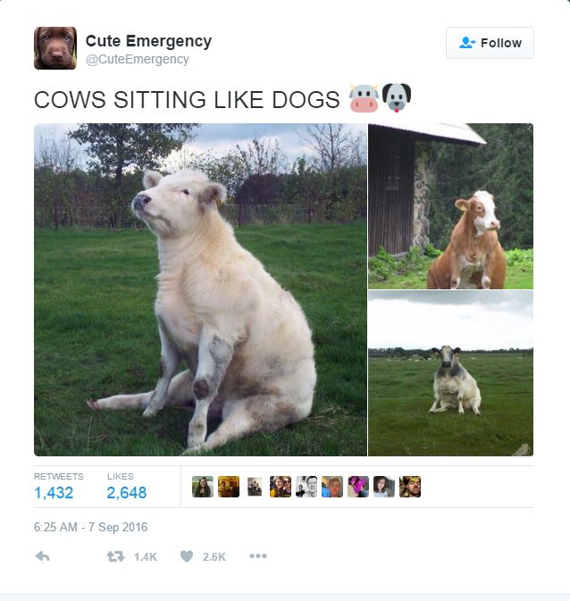
MLA formatting: Work Cited
Citing Twitter:
@CuteEmergency. “Cows sitting like dogs.” Twitter,
7 September 2016, 6:25 am,
https://twitter.com/CuteEmergency/status/773512415573073920?lang=en
Citing Website:
Renee Cho et al. “The 35 Easiest Ways to Reduce Your Carbon Footprint.” State of the Planet, 27 Dec. 2018, news.climate.columbia.edu/2018/12/27/35-ways-reduce-carbon- footprint/.

