Slide 1
MLA 8th Edition
The Writing Center @ PSU

Slide 2
Why do MLA at all?
MLA is the standard documentation, style, and formatting system for academic writing in a variety of humanities fields
English
literary criticism, and cultural studies (“MLA Overview”)
MLA gives credibility to your paper
MLA citations ensure that you won’t plagiarize from the sources you use in your writing

Slide 3
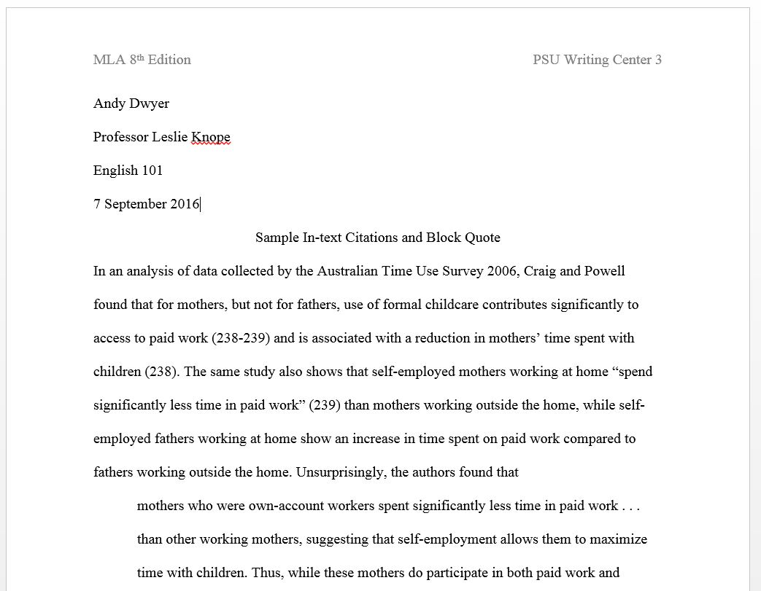
Basic MLA format & in-text citations

Slide 4
Works Cited

Slide 5
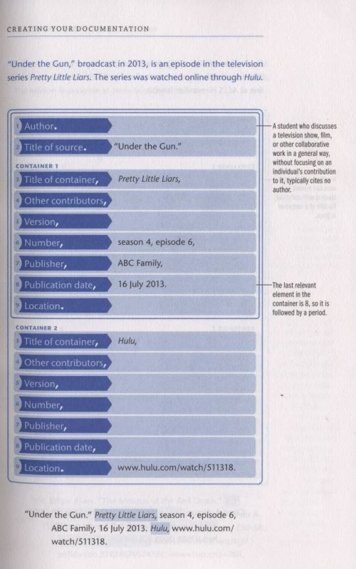
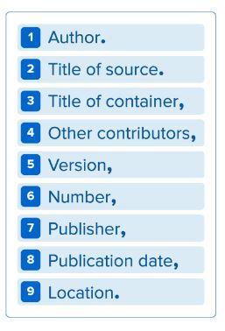
Core elements

Slide 6
Context sensitive

Slide 7
Citing a TV show:
Emphasizing the creator:
Emphasizing the performer:
Buffy the Vampire Slayer. Created by Joss Whedon, performance by Sarah Michelle Gellar, Mutant Enemy, 1997-2003.
Whedon, Joss, creator. Buffy the Vampire Slayer. Mutant Enemy, 1997-2003.
Gellar, Sarah Michelle, performer. Buffy the Vampire Slayer. Mutant Enemy, 1997-2003.
Citing one episode:
Emphasizing historical context:
Citing one episode on DVD:
“Hush.” Buffy the Vampire Slayer, created by Joss Whedon, performance by Sarah Michelle Gellar, season 4, episode 10, Mutant Enemy, 1999.
“Hush.” Buffy the Vampire Slayer, created by Joss Whedon, performance by Sarah Michelle Gellar, season 4, episode 10, WB Television Network,14 Dec. 1999.
“Hush.” Buffy the Vampire Slayer, created by Joss Whedon, performance by Sarah Michelle Gellar, episode 10, Twentieth Century Fox, 2003, disc 3.

Slide 8
Benefits

Slide 9
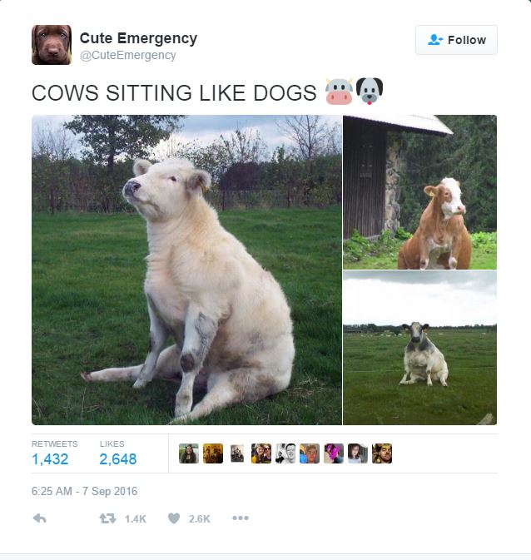
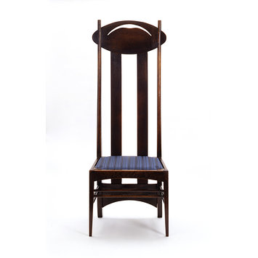
Mackintosh, Charles Rennie. Chair of stained oak.
1897-1900, Victoria and Albert Museum, London.
@CuteEmergency. “Cows sitting like dogs.” Twitter,
7 September 2016, 6:25 am,
https://twitter.com/CuteEmergency/status/773512415573073920?lang=en

