Slide 1
Chicago Manual of Style
The Writing Center @ PSU
February 10, 2016

Slide 2
Why We Use Chicago
Provide you with guidelines (a formula) for formatting essays
Offer a shared set of expectations for formatting within a discipline
Improve your credibility in using sources for support
Help you avoid accusations of plagiarism

Slide 3
Basic Formatting
Margins between 1” and 1.5”
Typeface should be readable, such as Times New Roman or Palatino
Font size should be no less than 10 pt. (preferably, 12 pt.)
Text should be consistently double-spaced (only exceptions: single-space block quotes, table titles, figure captions, and notes and bibliographies internally)
Notes and bibliographies should be singled-spaced internally with an extra line space between each entry
Page numbers should begin in the header of the first page of text (not the title page) with Arabic number 1
Subheadings should be used for longer papers.

Slide 4
Sample CMS Author-Date Style Paper
The link below leads to an example essay written in CMS, Author-Date style (meaning in-text citations are used as opposed to footnotes). As you look through this PowerPoint, use the example essay for reference.
  https://owl.english.purdue.edu/media/pdf/1300990757_717.pdf

Slide 5
Sample CMS Notes & Bibliography Style Paper
The link below leads to an example essay written in CMS, Notes and Bibliography style (meaning footnotes are used as opposed to in-text citations). As you look through this PowerPoint, use the example essay for reference.
https://owl.english.purdue.edu/media/pdf/1300991022_717.pdf

Slide 6
Major Paper Sections
Title Page
Main Body
References

Slide 7
Title Page
The title should be centered a third of the way down the page.
Your name and class information should follow several lines later.
For subtitles, end the title line with a colon and place the subtitle on the line below the title.

Slide 8
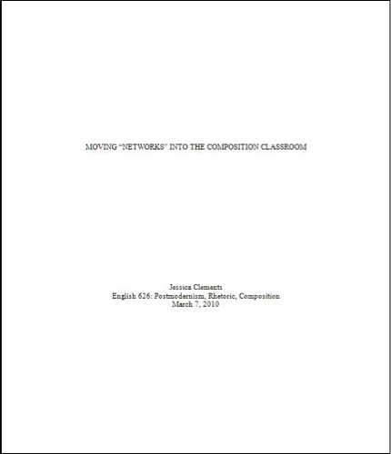
Title
Your name and course information
Source: Clements et al. 2011.

Slide 9
Main Body: Capitalization and Titles
Capitalize titles in text, notes, and bibliographies in “headline style”
Treat titles in the text as well as in notes and bibliographies with quotation marks or italics based on the type of work they name.
  Titles of Larger Works: Books or Periodical Titles
  “Titles of Shorter Works: Articles or Chapter Titles”
Otherwise, take a minimalist approach to capitalization.
    Use lowercase terms to describe periods, for example, except in the case of proper nouns (e.g., “the colonial period,” vs. “the Victorian era”).

Slide 10
Main Body: Block Quotes
If, after typing out a quotation, it comes to five lines or longer, put the quotation in “block” format. Block quotes
  Are singled-spaced
  Have no quotation marks
  Have an extra line space immediately before and after them
  Are indented in their entirety .5”
  ****There is an example of a block quote on page 11 of the Note and Bibliography style example essay.

Slide 11
References
In CMS formatting, there are two methods of citation:
  Notes and Bibliography style, and
  Author-Date style
The two methods of citation do not affect the way sources are cited in the References/Bibliography page; however, whichever method of citation is being used determines whether that page is titled “References” or “Bibliography”

Slide 12
References: Formatting the Reference Page
Label the first page of your back matter, and your comprehensive list of sources, “Bibliography” (for Notes and Bibliography style) or “References” (for Author-Date style).
Leave two blank lines between “Bibliography” or “References” and your first entry.
Leave one blank line between remaining entries.
List entries in letter-by-letter alphabetical order according to the first word in each entry.

Slide 13
References: General Citation Format
Write out publishers’ names in full.
Do not use access dates unless publication dates are unavailable.
If you cannot ascertain the publication date of a printed work, use the abbreviation “n.d.”
Provide DOIs instead of URLs whenever possible.
If you cannot name a specific page number when called for, you have other options: section (sec.), equation (eq.), volume (vol.), or note (n.).

Slide 14
References: Authors
Use “and,” not an ampersand, “&,” for multi-author entries. For two to three authors, write out all names.
For four to ten authors, write out all names in the bibliography but only the first author’s name plus “et al.” in notes and parenthetical citations.
When a source has no identifiable author, cite it by its title, both on the references page and in shortened form (up to four keywords from that title) in parenthetical citations throughout the text.

Slide 15
References: Books
Single Author
  Zakharov, Prokhor. For I Have Tasted the Fruit. Sparks, Maryland: Morgan Publishing, 1999.
Two to Four Authors
  Caldwell, Lynn, Tristan C. Landwehr, and Janet Zepernick. The Quintessential Theory of Everything. Girard, Kansas: Emanual Haldeman-Julius, 2011.
More than Four Authors
  List normally in References/Bibliography page; in-text, list only the first author, followed by “et al.”
Chapter or Section of a Book
  Kelly, John D. “Seeing Red: Mao Fetishism, Pax Americana, and the Moral Economy of War.” In Anthropology and Global Counterinsurgency, edited by John D. Kelly, Beatrice Jauregui, Sean T. Mitchell, and Jeremy Walton, 67–83. Chicago: University of Chicago Press, 2010.

Slide 16
References: Articles
Journal Article
  Cervantes, Gabriel. "Convict Transportation and Penitence in Moll Flanders." ELH 78, no. 2 (2011): 315-336.
Newspaper Article
  Deo, Nisha. “Visiting Professor Lectures on Photographer.” Exponent (West Lafayette, IN), Feb. 13, 2009.
Popular Magazine Article
  Mendelsohn, Daniel. “But Enough About Me.” New Yorker, January 2010.

Slide 17
References: Web Sources
Web Page
  Mister Jalopy. “Effulgence of the North: Storefront Arctic Panorama in Los Angeles.” Dinosaurs and Robots. Last modified January 30, 2009. http://www.dinosaursandrobots. com/2009/01/effulgence-of-north-storefront-arctic.html.
Blog Post
  Susan Woodring, September 17, 2010 (2:31 a.m.), comment on J. Robert Lennon, “How Do You Revise?,” Ward Six (blog), September 16, 2010 (8:39 a.m.), http://wardsix. blogspot.com/2010/09/how-do-you-revise.html.

Slide 18
References: Other
The reference examples included in this PowerPoint is by no means all-inclusive. For further examples, check out the Purdue OWL website:
  https://owl.english.purdue.edu/owl/resource/717/03/

Slide 19
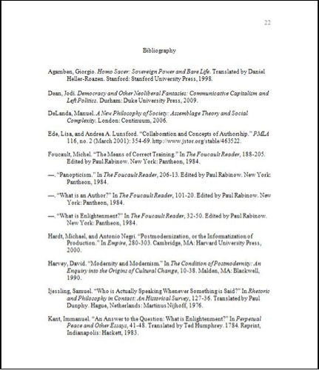
Citations single-spaced
Multiple works by same
author denoted by –
One line of space
between citations
Source: Clements et al. 2011.

Slide 20
Other Important CMS Components
Headings
Tables & Figures
In-Text Citations (for Author-Date style)
Footnotes (for Notes and Bibliography style)

Slide 21
Headings: Formatting
L1: Centered, Bold or Italic Type, Headline-Style Capitalization
L2: Centered, Regular Type, Headline-Style Capitalization
L3: Flush Left, Bold or Italic Type, Headline-Style Capitalization
L4: Flush left, roman type, sentence-style capitalization
L5: Run in at beginning of paragraph (no blank line after), bold or italic type, sentence-style capitalization, terminal period.

Slide 22
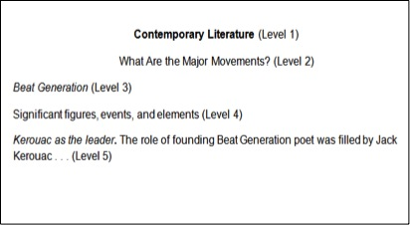
Headings Example
Source: Clements et al. 2011.

Slide 23
Tables & Figures
Position tables and figures after the paragraph in which they’re described.
Cite the source of the table and figure information with a “source line” at the bottom of the table or figure.
  Introduce citations with the word “Source(s),” followed by a colon, and ended with a period.
  No parentheses in citation
  Give every table a number and a (short and descriptive) title flush left on the line above the table.
  Give every figure a number and a caption flush left on the line below the figure.
  Number tables and figures separately in the order you mention them in the text.
    In the text, identify tables and figures by number (“in figure 3”) rather than by location (“below”).

Slide 24
Table Example

Slide 25
Figure Example

Slide 26
Author-Date Style
Used in physical, natural, and social sciences (if in history, refer to “Footnotes” slides)
Each time a source is used in the text, it must be cited in parentheses.
Parenthetical citation comprises the author’s last name, the publication date, and the page number of the source, when applicable.
Ultimately for Foucault, “Power was the great network of political relationships
among all things,” (Thomas 2008, 153), and Foucault (1984a) represents a powerful
figure in postmodern thought because he asserts that power is what produces our reality.

Slide 27
Author-Date: Parenthesis Placement
Author-Date style in CMS is similar to APA in-text citations in that if information that belongs in the parenthesis appears in the sentence’s lead-in phrase, it does not have to be repeated in the parenthesis at the end of the sentences. Here are a few examples:
  In Harry Potter and the Chamber of Secrets, J. K. Rowling (1998) explains that “Harry had never experienced fear like this before” (122).
    (The above quote is made up. Sorry Ms. Rowling!)
  Sommers (2012) reasons that fear is an uncontrollable force (12-13).

Slide 28
Notes and Bibliography Style: Footnotes
Footnotes are used in the history field in place of in-text citations.
Footnotes appear at the bottom of each page in which one or more sources was/were cited.
Footnotes provide the same information that is listed in the Bibliography; however, this information is presented in a different order (examples are provided in upcoming slides).

Slide 29
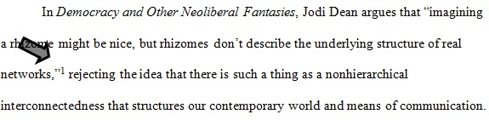
Footnotes: In the Text
Note numbers begin with “1” and follow consecutively throughout a given paper.
Note numbers are superscripted.
Note numbers are placed at the end of the clause or sentence to which they refer, after any and all punctuation.
Source: Clements et al.

Slide 30
Footnotes: Formatting
Note numbers are full-sized, not raised, and followed by a period (superscripting note numbers in the notes themselves is also acceptable).
Indent footnotes just as you would a regular paragraph (first line indented .5” from the margin; subsequent lines formatted flush left).
Leave an extra line space between footnotes.
Place commentary after documentation when a footnote contains both, separated by a period.
  In parenthetical citation, separate documentation from brief commentary with a semicolon (example on page 17 of the Author-Date sample paper).
  Do not repeat the hundreds digit in a page (so if you are citing information that you found ranging from pages 324 to 382 of a source, write it like this in your citation: 324-82)

Slide 31
Footnotes: Repeating a Footnote
Each time you cite a source that you have already cited, use a shortened citation.
  For books, journal articles, or newspaper articles, use the author’s last name, shortened source title, and the page number
    Grazer and Fishman, Curious Mind, 37.
  For websites, use the author (or corporate author), if applicable, and then the article/website title (use only the website/article title if there is no author)
    Bouman, “Black Hole.”

Slide 32
Footnotes: Citation Examples
On the next several slides, “N” represents the citations for footnotes, while “B” represents the citations for the corresponding citations as they would appear in the Bibliography.

Slide 33
(N) vs. (B): Books
Book by One Author
  (N):
1. William Faulkner, Absalom, Absalom! (New York: Vintage Books, 1990), 271.
  (B):
Faulkner, William. Absalom, Absalom!. New York: Vintage Books, 1990.
Book by Multiple Authors
  (N):
2. Scott Lash and John Urry, Economies of Signs & Space (London: Sage Publications, 1994), 241-51.
  (B):
Lash, Scott, and John Urry. Economies of Signs & Space. London: Sage Publications, 1994.

Slide 34
(N) vs. (B): Books, cont’d.
Book with Author and Editor
  (N):
3. Edward B. Tylor, Researches into the Early Development of Mankind and the Development of Civilization, ed. Paul Bohannan (Chicago: University of Chicago Press, 1964), 194.
  (B):
Tylor, Edward B. Researches into the Early Development of Mankind and the Development of Civilization, Edited by Paul Bohannan. Chicago: University of Chicago Press, 1964.
Article, Chapter, Essay, Short Story, etc., in an Edited Collection
  (N):
4. Peter Chilson, "The Border," in The Best American Travel Writing 2008, ed. Anthony Bourdain (Boston: Houghton Mifflin Company, 2008), 46.
  (B):
Chilson, Peter. "The Border." In The Best American Travel Writing 2008, edited by Anthony Bourdain, 44-51. Boston: Houghton Mifflin Company, 2008.

Slide 35
(N) vs. (B): Periodicals
Article from an Electronic Journal
  (N):
1. Henry E. Bent, “Professionalization of the Ph.D. Degree,” College Composition and Communication 58, no. 4 (2007): 141, accessed December 5, 2008, http://www.jstor.org/stable/1978286.
  (B):
Bent, Henry E. "Professionalization of the Ph.D. Degree.” College Composition and Communication 58, no. 4 (2007): 0-145. Accessed December 5, 2008. http://www.jstor.org/ stable/1978286.
Article from an Online Magazine
  (N):
1. Barron YoungSmith, Green Room, Slate, February 4, 2009, http://www.slate.com/id/2202431/.
  (B):
YoungSmith, Barron. Green Room. Slate, February 4, 2009. http://www.slate.com/id/2202431/.

Slide 36
(N) vs. (B): Periodicals, cont’d.
Article from a Print Magazine
  (N):
1. Emily Macel, “Beijing’s Modern Movement,” Dance Magazine, February 2009, 35.
  (B):
Macel, Emily. “Beijing’s Modern Movement.” Dance Magazine, February 2009.
Article from a Newspaper
  (N):
1. Nisha Deo, “Visiting Professor Lectures on Photographer,” Exponent (West Lafayette, IN), Feb. 13, 2009.
  (B):
Deo, Nisha. “Visiting Professor Lectures on Photographer.” Exponent (West Lafayette, IN), Feb. 13, 2009.

Slide 37
(N) vs. (B): Other Sources
Blog Entry
  (N):
1. Emily Macel, “Beijing’s Modern Movement,” Dance Magazine, February 2009, 35.
  (B):
Macel, Emily. “Beijing’s Modern Movement.” Dance Magazine, February 2009.

Slide 38
Resources
The Purdue OWL’s Chicago Manual of Style Guide
The Chicago Manual of Style, 16th Edition (some content requires subscription)
The Writing Center @ PSU!!

Slide 39
Bibliography
Clements, Jessica, Elizabeth Angeli, Karen Schiller, S. C. Gooch, Laurie Pinkert, and Allen Brizee. “General Format.” The Purdue OWL. October 12, 2011. http://owl.english.purdue.edu/owl/resource/717/13/.

