Slide 1
APA FORMATTING: TITLE PAGE & HEADER
The Writing Center @ PSU
2022 - 2023

Slide 2
Recall the basics
Margins (1” and 1.5”)
Times New Roman or Palatino
WHY IS APA USEFUL?
Font size 12 pt.
Improve your essays and reports
Use sources for support
Help you avoid plagiarism
Text is double-spaced
Except for quotes, table titles, and figure captions (single)
Subheading for longer papers
Number your pages

Slide 3
FIRST, THE TITLE PAGE
1
Page Number
The title is centered a third of the way down the page*
Your name, class information, instructor and due date*
Optional : for subtitles, end the title line with a colon and place the subtitle on the line below the title.
*APA or UFO, that’s the question man
*Alex Paul Allister
English science 626 : final essay. Composition
Dr. Priya C. Agatwal
2/22/2022

Slide 4
APA citation in a text
Three kinds of information to be included in in-text citations:
The author’s last name and the work’s date of publication must always appear, and these items must match exactly the corresponding entry in the references list. Author name and publication date are separated by a comma, example: (Smith, 2010). The third kind of information, page number, appears only in a citation to a direct quotation, example: (Smith, 2010, p. 417).
APA prefers writers use attribution phrases to introduce borrowed information:
According to Anderson (2017), people need to eat healthier, even if Wendy’s is cheaper.
Benny and Jetson (1979) argue that she has electric boots and a mohair suit. They read it in a magazine.
To understand why Sally sells seashells, Paulson et al.* (2008) state that it’s because she lives by the seashore.
*et al. for more than 3 authors.

Slide 5
APA formatting: references list
Last, F. M. (Year). Title of article: And the part after the colon. Name of Periodical, V(I), 135-158. https://doi.org/10.1037/a0013097
U.S. Equal Employment & Opportunity Commission. (n.d.). Remedies for employment discrimination. https://www.eeoc.gov/employers/remedies.cfm
Wow! So many colors here! My retina is on fire
>

Slide 6
APA formatting: reference list
Referencing Websites:
World Health Organization. (2018, May 24). The top 10 causes of
death. https://www.who.int/news-room/fact
-sheets/detail/the-top-10-causes-of-death
YouTube Video:
Author
Bozeman Science. (2014, March 10). Integumentary system
[Video]. YouTube. http://www.youtube.com/watch?v=
z5VnOS9Ke3g&feature=share&list=PL0mifQXDgbZy8
-UR936WkJcALVm2qiVq3&index=3
Year of publication
Title of work (italic)
URL
Website with government agency as author:
National Heart, Lung, and Blood Institute. (2016,
December). Cardiac rehabilitation. U.S. Department of Health
& Human Services, National Institutes of Health.
https://www.nhlbi.nih.gov/health-topics/cardiac-rehabilitation

Slide 7
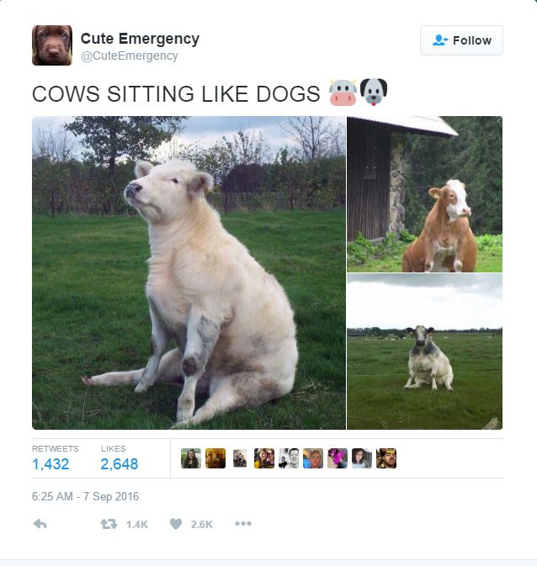
APA formatting: reference list
Twitter:
@Cute Emergency[Tweet]. Twitter. https://twitter.com/CuteEmergency/status/773512415573073920?lang=en
Dictionary:
Merriam-Webster.(n.d).Culture.-In”Merriam-Webster.com-dictionary.-Retrieved-September-9,-2019,-from”https://www.merriam-webster.com/dictionary/culture.

