Slide 1
Student Success Programs
StudentSuccess@pittstate.edu
@PSUSuccess
Strategies for Test Prep & Test Taking
Notes:
Hello! Welcome to our Academic Success Workshop Surviving Mid-Terms.
Today, we’re going to Talk about Strategies for Test Prep and Testing taking for your upcoming midterms.
First off, you might be asking yourself, “What is a mid-term?”
A mid-term is quiz or test at the middle of the semester; not necessarily worth more in your grade but an important check-in to know how you are doing in the class (this is important so that you have information as the withdraw date is quickly approaching)
**The presenter notes on each slide serve as a guide for you to read, as if a presenter was speaking with you in person! Let’s get started!

Slide 2

Is This Going To Be On The Test?
Assess
  Where Am I?
Learn
  Where Do I Want To Go?
Plan
  How Do I Get There?
Notes:
These are the topics that we’re going to go over today:
Assess, “Where am I?”
Then Learn, “Where do I want to go?”
Lastly how to plan, “How do I get there?”

Slide 3
Assess
Where Am I?
- Am I prepared for my courses?
- Am I preparing well for my tests?
- Do I use good test taking strategies?
“Always have a plan and believe in it.
Nothing good happens by accident.”
-Chuck Knox, NFL Coach
Notes:
First off with Asses…
We want you to initiate a self check…
I want you to think to yourself, am I prepared for my courses?
Do I feel confident or at least semi-confident?
Am I preparing well for my tests?
Do I use good test taking strategies?
Think about those three questions real quick and give yourself an honest answer.

Slide 4
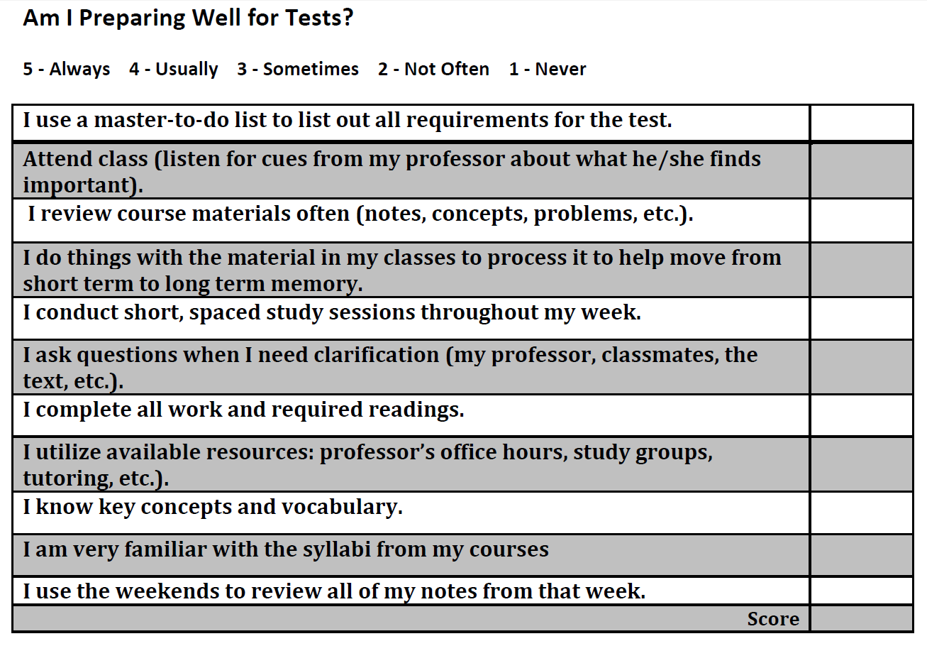
Notes:
You will need to the document, “Am I preparing well for my tests?”. (There is a link on the Student Success Center Website, at the same location where you found this PowerPoint)
Take a minute or two to fill out the questionnaire and reflect on your answers.
On this slide, the document, “Am I preparing well for my tests” is available for you to view. You may choose to look off the slide or to print out the document for use.
Directions:
On a piece of paper, I want you to answer these questions with a 5,4,3,2,1. (5 being always and 1 being never… reference the document scale)
Take some time to read through each question and give yourself an honest rating.
Once you have finished add up your scores.
If your score is:
40-55: you are preparing well for your tests
15-39: you need a little tune up
11-14: your test preparation needs some major adjustment
Everyone can focus on the areas where you scored 1s & 2s to improve your test preparation! Take note of this self check to see where you are currently at!

Slide 5
Assess: Am I prepared for my courses?
  I choose to do my work at times when I am most alert.
  I make sure that my environment is conducive to studying by being comfortable and removing distractions.
  I preview material before class and review material after class.
  I attend and participate in class.
  I get enough rest, exercise and eat healthy foods.
  I am able to balance my work, class, study, and leisure time.
  I am aware of how I spend my time.
  I am able to recognize my tendencies to procrastinate and use strategies to overcome these
Notes:
Much of the work in college is done outside the classroom. Succeeding academically begins at the start of the semester, not just in the days of studying before an exam.
Here are some statements for you to conduct a self check. Can you answer yes to these statements?
Am I prepared for my courses?
I choose to do my work at times when I am most alert.
I make sure that my environment is conducive to studying by being comfortable and removing distractions.
I preview material before class and review material after class.
I attend and participate in class.
I get enough rest, exercise and eat healthy foods.
I am able to balance my work, class, study, and leisure time.
I am aware of how I spend my time.
I am able to recognize my tendencies to procrastinate and use strategies to overcome these
These are all statements for students that are prepared for their courses!

Slide 6
Best Practices
  Arrive : Go to class regularly
  Arrive on time: early is on time, on time is late
  Sit near front of room to minimize distractions: Who you sit near/Where you sit
  Syllabus: instructor, course & assignment info; best way to contact instructor; office hours
  Take notes & review them before/after class
  Read textbook assignments (often listed in syllabus)
  Examine returned homework & tests
Notes:
So what can you do to help yourself before Midterms hit?
Best practices
Arrive: Go to class regularly
Arrive on time: early is on time, on time is late
Whether it is a Zoom meeting online or an in person class, show up early!
Sit near front of room to minimize distractions: Who you sit near/Where you sit
If you are an online student, make sure that you have a distraction free environment.
Go to the library, have your desk in your room with the door shut
Syllabus: Know the instructor’s name, course & assignment info, the best way to contact instructor, and know when the instructor’s office hours are.
Take notes & review them before and after class
Read textbook assignments (the are often listed in syllabus)
Examine returned homework & tests
Think of preparing for class as a ‘mental warm-up’. Review the assigned material/reading before class, review your notes from previous class session(s) and you will feel prepared for class, quizzes and tests!

Slide 7

Assess: Am I preparing well for my tests?
Study Cycle
Intense Study Sessions
General Tips
Notes:
Test prep: begins at the start of the semester, not just in the days of studying before an exam! Next we will talk about the study cycle, intense study sessions and general tips.
As we continue on with this presentation, think about how the following tips might help you adjust and/or improve your approach to test prep and studying, in general.

Slide 8

Preview
Attend
Review
Study
Assess
Study Cycle
Notes:
The study cycle is something you do continually, from the beginning of the semester, rather than thinking of ‘studying’ as something you do right before an exam. It should be a continual process of short, regular review sessions and a habit of keeping course materials, notes, reading assignments and looking over these continuously. This approach allows you to study SMARTER, not harder!
A brief overview on the Study Cycle:
Preview: identify relevant text & notes
Example: skimming/scanning your textbook before class
Attend: listening & reading actively; connect textbook & lecture info
Example: Be an active listener, take notes, asking questions (whether that means asking questions in class or emailing the instructor through email or canvas)
Review: fill in gaps (if something does make sense… ask!) meet w/ teachers, other students, tutors etc…, especially when items in your notes aren’t clear to you/don’t make sense.
Study: organize information in your notes. Study when & where you are most alert and plan your time within a schedule.
Assess: Conduct self-tests through practice tests, study guides, flashcards, etc. Make sure to put ideas in your own words! Or you might also choose to work with a study partner or group to asses your knowledge.

Slide 9
A Note on Review…
10 minutes 5 minutes 2-4 minutes
of study of study of study
100%
- - - - - - - - - - - - - - - - - - - - - - - - - - - - - - - - - - - - - - - - - - - - - - - - - - - - - - - - - - - - - - - - - - -
Recall
Day 1 Day 2 Day 7 Day 30
Short-Term Memory Long-Term Memory
Notes:
*less than 20 minutes of review each month can help keep info in the 80-100% range of recall!
We lose around 80% of what we read unless we review it immediately and frequently. When we read our textbooks, review and organize lecture notes and frequently take 5-10 minute mini-study sessions we avoid having to essentially re-learn the material before an exam.
This chart shows us our Short-Term Memory (Blue) vs. Long Term Memory (Green).
On Day 1, when we learn about something, we typically can remember abut 100% of what we learned. Then the next couple days, we don’t review the information, so we slowly forget what we learned. And there is no long term memory associated with it.
But, after the first day, if we review our notes for 10 minutes on the second day, 5 minutes on day 7 and 2-4 minutes after that.. Our long term memory kicks in and we are able to remember information.
So, this graph really shows you what a max of 10 minutes of reviewing and studying can do for your long term memory, which ultimately help you from spending a day or week trying to cram and relearn information before a test.
If you approach studying and test prep with the study cycle in mind, you will naturally develop a pattern of regular, short review sessions that allows you to retain more, study smarter/not harder, and hopefully get more from your courses and education!
Make sure you spend a little bit of time reviewing your notes because your future self will thank you!

Slide 10

Intense Study Sessions
  Set a Goal (1‐2 min)
    Decide what you want to accomplish in your study session
  Study with Focus (30‐50 min)
    Interact with material‐ organize, concept map, summarize, process,
    re‐read, fill‐in notes, reflect, etc.
Notes:
Intense Study Sessions are typically anywhere from 30-50 minutes. We recommend these 30-50 minute study sessions over the course of a semester because it allows you to learn over time, rather than try to cram it all in before a test.
First, when you are in a study session, set a goal for yourself. What do you want to accomplish in your study session?
Example: I want to look over the phases of the cell cycle today. Be able to remember all of the phases.
Then, study with a focus for 30 to 50 minutes.
While you are studying, interact with the material, make a concept map, rewrite things, summarize. Basically engage in the material in any way that helps you remember it (everyone has a different learning style… what works for someone else, might not work for you or vice versa). Try to find what works best for you!
These intense study sessions help you learn content over the course of the semester, make connections, enjoy learning & your college experience more!

Slide 11
Intense Study Sessions
  Reward Yourself (10‐15 min)
    Take a break – call a friend, play a short game, get a healthy snack
  Review (5 min)
    Go over what you just studied
Notes:
It’s also important that you reward yourself when you’ve hit that 30 to 50 minute mark. You can do this by taking a break.
Example: call a friend, play a game or go make a snack.
Your yourself a brain break!
Once you rewarded yourself, go back and do a quick five minute review. Read back over what you just studied or be able to summarize things to yourself. Plan to work on anything that you still aren’t confident about. You can plan to meet with a tutor if necessary!

Slide 12
Learn: General Tips
Do I Use Good Test-Taking Strategies?
Before the test, I double check the time and location.
I bring needed materials with me to the test.
I arrive on time for tests. (Early is on time!)
I preview the test before I begin & I review my answers before turning in the test.
I read all directions carefully & I read the entire question carefully before answering.
Notes:
General Tips for Good Test Taking Strategies:
Before the test, double check the time and location.
Nothing gives you more anxiety than to realize you missed your test or you’re in the wrong place.
If you are an online student: check what time the test is open and the date.
Bring needed materials with you to the test.
Do you need a calculator? Do you get a 3x5 notecard for the test? Don’t forget a pencil or a pen
If you are an online student: Do you need a lockdown browser? Is it open note or open book?
Arrive on time for tests.
(Early is on time!) Give yourself some time to be in class and review your notes before the test
Preview the test before I begin & I review my answers before turning in the test.
Once the professor hands out the test, preview it. See what type of test it is? Multiple choice, short answer, true/false or a combination.
After you have finished, review your answers, make sure you didn’t skip any on accident. Or that your scantron is filled out completely and you are not off a bubble.
Read all directions carefully & read the entire question carefully before answering.
Think it through and process all of the details and info
Sometimes questions have multiple parts to them
The course syllabus will have much of this info, but is subject to change. Be sure to check Canvas, email, and listen for announcements in class regarding test times, dates, content, etc…
At the end of the day, the responsibility rests on you, the student, to be aware of and manage this information! Be proactive!

Slide 13
Learn: General Tips
Do I Use Good Test-Taking Strategies?
I answer the easiest questions on the test first.
Before writing an essay, I organize my thoughts with an outline.
My responses are legible and do not use abbreviations or slang words.
I cross out choices I know are incorrect
I attempt every question: If I do not know an answer, I make the best educated guess.
If I freeze on a test, I use deep breathing and positive self-talk to get through it. (6 in – 8 out)
Notes:
General Tips for Good Test Taking Strategies:
You don’t have to start the exam from the beginning and work to the end.
It’s ok to jump around, just be sure to review/double-check your test before you turn it in to make sure you’ve answered all questions.
Cross out choices that you know are incorrect.
Attempt every question, even if I don’t know the answer make an educated guess.
Give yourself a chance. You might get it right, or get partial credit
A helpful breathing technique…6 in - 8 out: inhale for 6 seconds, exhale for 8.
Do this 3 times before the test begins and when/if you get stuck or start to panic.
You will need to the handout, “POSSE” (There is a link on the Student Success Center Website, at the same location where you found this PowerPoint)
You can also refer to the POSSE handout, specifically the second page (Specific Strategies to Improve Learning).
The POSSE handout gives good suggestions on how to prepare for certain types of tests, depending on the material/content of the test/course.
This a go-to reference for tips and a more detailed approach to test prep and studying that you may choose to keep on hand.
Note: The page on ‘Objective Tests’ refers to tips on Multiple Choice questions. (objective = multiple choice)

Slide 14
Plan: General Tips
  Access campus resources
    Office hours, tutors, workshops, etc…
  Take care of yourself
  Get connected
  Set goals
    Reward yourself for meeting those goals
  Manage your time effectively
Notes:
As a student on campus, you have access to tons of resources… do not let these go to waste!
Resources:
Office hours for your professor.
Don’t be afraid to stop by and ask for help. They actually love when you stop by!
Keep, correct & review all returned quizzes, tests & papers. Speak with the teacher if you are unsure of correct answers to questions you missed.
We have tutors here at Student Success!
If we do not have a tutor, we can try to help you find one.
Or ask your professor if they know of anyone that may be able to help.
We also have these Academic Success Workshops, all available to you online, or in person.
If the scheduled workshop time/date does not work for you, we can set up an individual time to go over a workshop.
Again, you just have to reach out and ask!
Take care of yourself!
Eat healthy, go exercise and do things that you enjoy.
Set goals!
Then, reward yourself for meeting those goals
Manage your time effectively.
Stick to a planner, to do list, anything that helps you plan out what you need to get done.
If you need help with time management, visit our time management Academic Success Workshop PowerPoint!

Slide 15
Plan: General Tips
Use Your Resources!
  StudentSuccess@pittstate.edu
  Tutoring: Search ‘tutoring’ at www.pittstate.edu
Flashcards
Keywords
Examine Returned Tests
Reducing Test Anxiety
Notes:
More resources include:
Student Success Center (Student Success Counselors (StudentSuccess@pittstate.edu))
Tutors
Student Health Center/Anxiety Counseling & Tips,
Professors
RA’s
Classmates/study partners/groups
Use flashcards, keyword, or examine returned tests to get a better understanding.
You can use the handout, “General Test Tips & Examining Returned Tests” as a resource!(There is a link on the Student Success Center Website, at the same location where you found this PowerPoint)
Read over the handout for tips on how to review a test!

Slide 16

Action Plan
Unless you try to do something beyond what you have already mastered,
you will never grow.
– Ralph Waldo Emerson
Notes:
You will need to the handout, “Create an Action Plan” and “Keyword Bookmark” (There is a link on the Student Success Center Website, at the same location where you found this PowerPoint)
It is now time to fill in blanks on ‘Create an Action Plan’ worksheet with some of the tips shared today. This worksheet allows you to identify strategies, set goals and track your progress. We highly recommend using this in classes that you are struggling with or before a test.
Again, remember that we offer tutoring. PSU offers tutoring all across campus! Here is the link to find out which tutors are available.
https://www.pittstate.edu/office/student-success-programs/tutoring.html#undefined2
If a course does not currently have a tutor, ask your instructor if they know of anyone who would be willing to tutor. Or try to create a study group with your classmates.
The keyword bookmark is especially useful for short answer and essay questions. It helps break down essay questions and guide development of an outline for essays that is more targeted to the specific question(s) that the teacher is asking. This keeps the essay writing and thought process on-task. Can be used during a test or just as students are working to complete essay or writing assignments. Again, this is just another resource for you.

Slide 17
First Year Programs
StudentSuccess@pittstate.edu
Questions??
Email: studentsucdess@pittstate.edu
Follow us on Social Media:
Facebook: PSU Student Success Center
Instagram: @psusuccess
Twitter: @psusuccess
Strategies for Test Prep & Test Taking
Notes:
If you have any questions, need clarification or would like an individualized plan, please contact Student Success Programs.
Student Success Programs
Axe Library 113
studentsuccess@pittstate.edu
620-235-6578
Be sure to give us a follow on our social media accounts to keep you updated on Academic Success Workshops, study tips and more!
Facebook: PSU Student Success Center
Instagram: @psusuccess
Twitter: @psusuccess

Slide 18
References
Aspire Program. Keene State College. (accessed October 2010). No-Nonsense Note Taking. Retrieved from http://www.keene.edu/aspire/nonsense.cfm.
Center for Academic Success, Louisiana State University. (accessed October 2010). Note Taking and Comprehension. Retrieved from www.cas.lsu.edu.
Ellis, D. (1997). Becoming A Master Student(8th ed.). Boston, MA: Houghton Mifflin Company.
Heiman, M., & Slomianko, J. (2004). Learning to Learn(10th ed.). Somerville, MA: Learning to Learn, Inc.

