Slide 1
Research
is easy
Notes:
Hello! Welcome to our Academic Success Workshop on Research Rescue! We have teamed up with Robert Lindsey, one of Pitt State’s Axe Librarians, to bring you this presentation.
We will be discussing how to conduct research as a college student.
Lots of people stress about research, but some tips might reduce anxiety.
**The presenter notes on each slide serve as a guide for you to read, as if a presenter was speaking with you in person! Let’s get started!

Slide 2
How does the Web Work?
Spiders crawl the Web
Web pages are indexed
Google stores the data on 900,000-2.5 million servers in 12-15 different locations around the globe

Slide 3
Google Search Tips
Tip 3: Choose words carefully … For example, instead of saying my head hurts, say headache, because that’s the word a medical site would use.
Dictionary: Put define in front of any word to see its definition.
Calculations: Enter a math equation like 3*9123, or solve complex graphing equations.
Unit conversions: Enter any conversion, like 3 dollars in euros. Or 3 meters in feet.
https://support.google.com/websearch/answer/134479?hl=en
Notes:
Google has their own hints for searches. This slide highlights some of the things Google can do for you.

Slide 4
Google Search Tips 2
A search for site:nytimes.com to search site.
Exclude words from your search. For example, jaguar speed –car
Search for an exact match. "tallest building"
Search for wildcards or unknown words. For example, "largest * in the world".
Notes:
One of the things I use frequently is the site search. You can limit your search to only within a domain, such as rollingstone.com or huffpost.com for example.
The use of wildcards, with * is something very useful as well. It can be used to replace a letter also, for example wom*n will look for woman or women.

Slide 5
Google Advanced Search
https://www.google.com/advanced_search
https://www.google.com/advanced_image_search
Notes:
Google advances search will make the previous tips very easy to use.
Google Image search will allow you to search for an image, and this can be used to search for an original of a picture you find on social media to see if it has been doctored or altered.

Slide 6
Google Scholar
https://scholar.google.com/
Notes:
Google Scholar is different from regular Google. Google Scholar searches academic journals, papers, and books, and can be linked to our RefWorks citation tool.

Slide 7
Wikipedia
Always be wary of any one single source (in any medium—web, print, television or radio), or of multiple works that derive from a single source.
Where articles have references to external sources (whether online or not) read the references and check whether they really do support what the article says.
In most academic institutions Wikipedia, like most encyclopedias and other tertiary sources, is unacceptable as a source for facts in a research paper. Some encyclopedias such as Encyclopædia Britannica have notable authors working for them and may be cited as a secondary source in some cases…
https://en.wikipedia.org/wiki/Wikipedia:Researching_with_Wikipedia
Notes:
While we all use Wikipedia, most professors won’t allow Wikipedia as a source. However, if you go to the bottom of most Wiki articles, you will find links to articles and other sources. If you follow that and read those sources then you can cite them. Use Wikipedia as a source finder, not as a source. In research this is called chasing the footnotes.

Slide 8
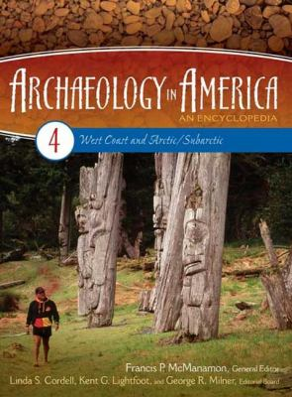
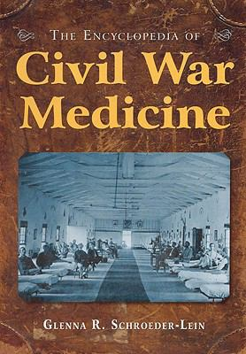
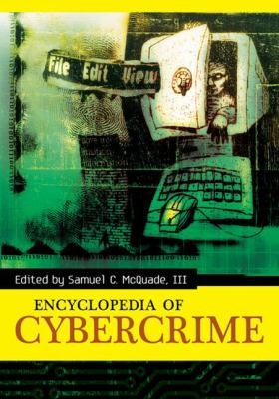
Notes:
We have many different kinds of encyclopedias. Get background information in a specialized encyclopedia, understand the issues, and perhaps focus your ideas. Also most specialized reference books have a short very good bibliography for further reading on the topic. Get those books and articles!

Slide 9
Reference Information/Statistics
Statistical Abstract of the United States
U.S. Census Bureau
National Center for Health Statistics
CIA World Fact Book
USA.gov
Notes:
Most of these sources have online sites, as well as the books version.
Statistical Abstract breaks down many aspects of American life, housing, crime, and more.
CIA World Fact Book has information about every country in the world. Economics, politics, and more.

Slide 10
InterLibrary Loan
If we don’t have what you need, we’ll get for you.
ILLiad https://pittstate.illiad.oclc.org/illiad/logon.html
WorldCat https://pittsburgstate.worldcat.org/

Slide 11
Notes:
Read for comprehension! Understand the material. Highlight key passages or take notes. “Skimming the Surface” 1st paragraph. ¾ of citations are from the first 3 pages of the cited text.

Slide 12
Questions?
Contact:
Robert Lindsey
Public Services Librarian
Pittsburg State University, KS
620-235-4887 rlindsey@pittstate.edu
Notes:
If you have any questions or need clarification please contact Robert Lindsey or Student Success Programs.
Robert Lindsey
Public Services Librarian
Pittsburg State University, KS
620-235-4887 rlindsey@pittstate.edu
Student Success Programs
Axe Library 113
studentsuccess@pittstate.edu
620-235-6578
Be sure to give us a follow on our social media accounts to keep you updated on Academic Success Workshops, study tips and more!
Facebook: PSU Student Success Center
Instagram: @psusuccess
Twitter: @psusuccess

