Slide 1
Learning in an Online Environment
Success Strategies for the
Online Classroom
Student Success Programs – Pittsburg State University – 113 Axe Library
Notes:
Hello! Welcome to our Academic Success Workshop on Learning in an Online Environment.
We will be discussing academic success strategies that you can use in an online classroom.
**The presenter notes on each slide serve as a guide for you to read, as if a presenter was speaking with you in person! Let’s get started!

Slide 2
Overview
Time Management
Communication with Professors
Practicing Good Study Skills
Focus on learning, not just your grades!
Notes:
We will be discussing self-awareness, time management, communication with professors and how to practice good study skills.
Before we start, I would just like to remind you to focus on learning, not just your grades. Some of you might be in prerequisites for other courses that you’ll need to take later on, so focus on the content to help yourself in the upcoming semesters. Or, some of you might be in classes that will be useful for your career! Again, focus on learning, not just your grades!

Slide 3
Time Management
Make a plan that works for you
  Spend time at the beginning of each week and day to plan & follow up on each day’s plan
Use a weekly/monthly planner to keep items in front of you
  ‘At A Glance’ somewhere you won’t be able to ignore
It’s OK to be flexible & modify your plan when you need to
Notes:
The first step in being successful as an online student is to manage your time well. Time management is one of the most important academic success skills a college student can master.
We would like for you to do a self check and answer these questions:
Do you currently have a planner?
Do you consistently use it?
If you do not, we have paper handouts at the Student Success Center that you can use to help plan with your semester, monthly, weekly and daily plans.
Where to buy planners (typically under $10 - $20):
Wal-Mart
Staples
Amazon
Any office supplies store
IMPORTANT:
Everyone has different styles, so it is important to find a plan that works for you! Some students love daily planners with specified times, while other students have found success in using a Calendar Dry Erase White Board.
**We will discuss different types of methods on the following slides
Once you have chosen a planner that works for you, spend time at the beginning of each month, week or day to add tasks and follow up. Be sure to cross off a task once it is accomplished or add tasks as they pop up.
Next, put your planner somewhere that you can’t ignore it. This could mean that you put your dry erase calendar above your desk in your room. Or you have your weekly planner open, to the correct week, and have it laying on your night stand. Find a place that works best for you!
Lastly, when you’re planning things, remember that it’s okay to be flexible and modify your plan!

Slide 4
Examples of Planning Methods – Daily Planner
Notes:
A daily planner may look similar to the one above. Daily planners will typically have time slots available for you to pencil in meetings, appointments, classes, etc. This is a detailed way to plan out your days, so that you know what activities you have planned for the day and what hours of the day you will have free.

Slide 5
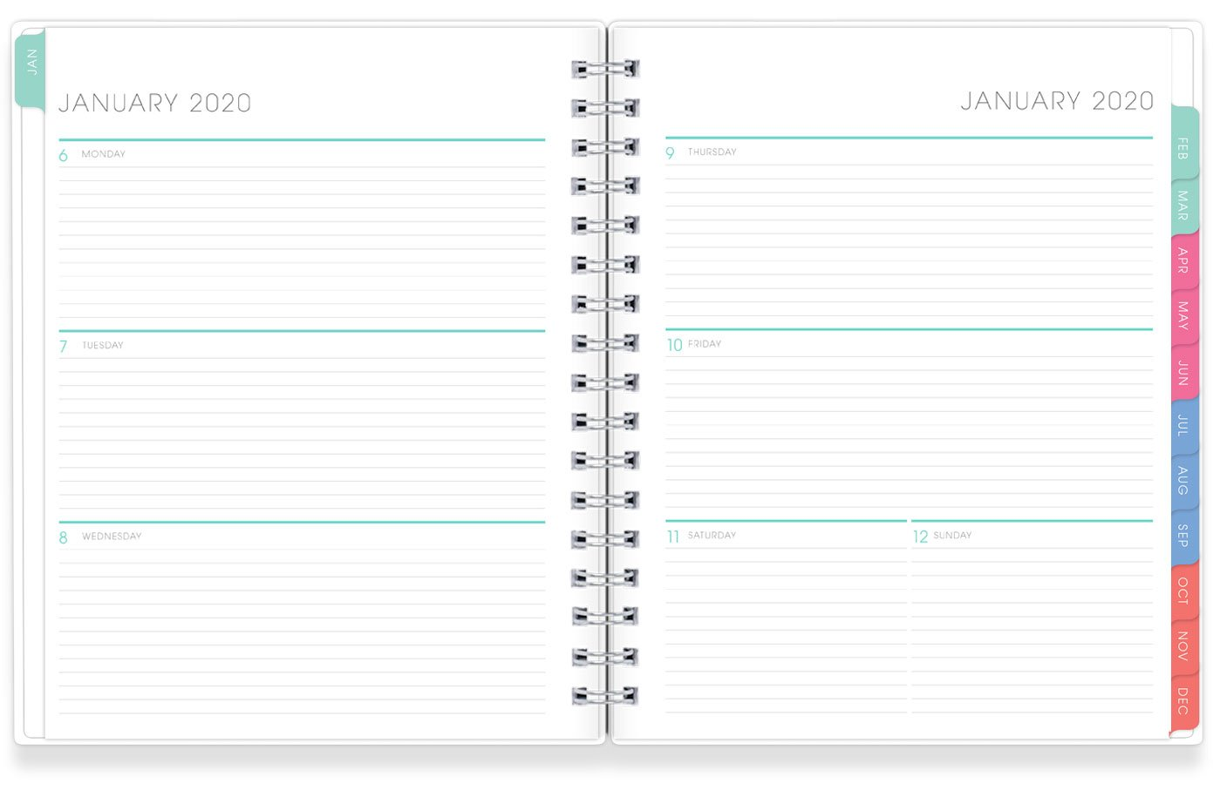
Examples of Planning Methods – Weekly Planner
Notes:
This is an example of a weekly planner! There are no time slots, but rather sections that are blocked off by days of the week. Typically you will write a to do list on each day. You might even write the time next to a task
Ex: “Discussion Post due at 5 PM”

Slide 6
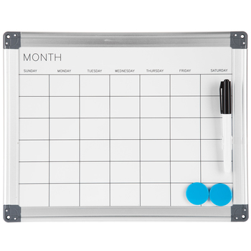
Examples of Planning Methods – Daily Planner
Notes:
Dry erase boards serve as an overview for personal time management. Typically you will write assignments, appointments and meetings on the white board. We recommend hanging the white board in a visible space so that you are always aware of your schedule.

Slide 7
Time Management
Revisit:
  ‘How Are You Spending Your Time?’
  ‘Setting Priorities’
Map what you’ve learned/created onto the Weekly/Monthly Planner
  Monthlies: occur same day every month
  Weeklies: occur same day of every week
  Dailies: specifics, do not occur regularly
Notes:
If you want to learn more about “How Are you Spending Your Time” and “Setting Priorities” you can go through our Time Management PowerPoint that is also located on the Academic Success Workshop’s website. It will give you an individualized look on what you are spending time on and what should be considered priorities in your schedule.
Once you have found a planner that works for you (Calendar Dry Erase Board, Weekly or Daily Planner, etc.) We recommend filling out a monthly planner with all of your information such as academic information/tasks, job information/tasks and personal information/tasks!
Monthlies: Monthlies are the activities that occur on the same day of every month.
Examples:
- Play golf on the 1st and 3rd Saturdays of the month.
- Volunteer at the soup kitchen on the 2nd Thursday of the month.
Weeklies: Weeklies are the activities that occur on the same day of every week.
Examples:
- Watch Grey's Anatomy Thursdays at 8pm.
- Meeting at 2 on every Friday
Dailies: Dailies are all the specifics that you need to schedule throughout a given week - activities that do not occur every month or every week but only every now and again.
Examples:
- Dental appointment on Monday at 2pm.
- Email status report to boss by 5pm this Friday.
End Result:
You see the complete picture of your life in one glance! Works extremely well for those with repetitive schedules. Also allows you to see when you have some free time!

Slide 8
Time Management
Make a Plan that works for YOU:
  5-10 minutes:
    Beginning of each week - lay out a plan
      Follow up on the plan each day
      Modify or add activities through the week as needed
  Reserve large blocks of time: working with complex concepts or new material
    Divide large blocks of time into smaller blocks to give yourself breaks
Notes:
As for weekly plans, take 5-10 min at the beginning of each week to write things out.
Then, during the week be sure to follow up on the plan.
If you accomplish tasks check them off or maybe you need to modify it.
Lastly, be sure to block off time for specific tasks, but also give yourself some little breaks in between because you can only focus for so long!

Slide 9
Time Management
Make a Plan that works for YOU:
  Leave some ‘room to breathe’ on your schedule
  Accountability: you may need to find a friend who can ask you monthly, weekly or perhaps daily how well you’re doing!
    Maybe you can get a friend or two to join you in your efforts to establish priorities and better manage your time!
Notes:
Allow yourself some “Room to Breathe”. There are always spontaneous and unexpected things that happen in our lives.
*Be realistic in scheduling: a real guide to help you plan your time well, not an unattainable wish list
*Be flexible: things happen from time to time that will cause you to have to reschedule/rework your plans
*Evaluate your schedule periodically: every few weeks look over your schedule to see how well it’s working for you &
how realistic it is & revise if necessary
If you need help setting up a planner or some individual help with time management. Like you just don’t know where to start… Contact Student Success Programs. We will help you get organized, set up and confident!
Student Success Programs
studentsuccess@pittstate.edu
Axe Library 113
620-235-6578

Slide 10
Communicate
Communicate with your Instructors
  Syllabus
    Office Hours
    E-mail/Canvas Communication
  Formal
    Doctor (Dr.), Professor, Mr./Mrs.
Notes:
The next step to being a successful in an online environment is communication. Just because you do not see the instructor face-to-face, does not mean that you are able to skip out on communication.
The course syllabus will typically hold a variety of information:
Office Hours:
Professors that teach online will typically have online or virtual office hours. These are hours that they will be at their computer, monitoring their email or you may also be able to reach them through phone.
Email/Canvas Communication:
Typically professors will tell you whether they prefer email or canvas communication. Be sure to look over the syllabus to find their preference!
When you choose to communicator with your instructor, use formal language when you greet them.
Include Doctor, Professor, Mr. or Mrs. Within your emails, canvas messages or even discussion posts.

Slide 11
Communicate
Suggested Conversations
  Use e-mail/Canvas to communicate with an instructor
  Discuss grades or assignments with an instructor
  Talk about career plans
  Discuss ideas from your readings outside of class
  Ask for feedback (written or oral) from instructors on your performance
Notes:
A lot of times students do not know what to talk about or how to start a conversation with their professors. Here are some ideas to get your conversation started!
First, use e-mail or canvas as your main source of communication. If you are struggling with the course content, do not be afraid to discuss grades or assignments with the instructor. Ask the instructor to go over a quiz or test with you, so that you can learn from mistakes. Next, you might choose to talk about career plans. If the instructor has connections with the career path that you would like to pursue, make that a talking point for you! You never know what opportunities may arise from it. Or you may choose to discuss ideas from your readings outside of class; bring up topics that you found interesting or that you need more explanation on. Lastly, you can ask for feedback on your performance! Feedback is an opportunity for you to grow as a professional… if you are struggling in a course, reach out and ask for guidance. Typically professors are more than willing to take time outside of the class to explain topics!

Slide 12
Common Online Course Components
Discussion Postings
  Spend time each day reading posts
  Create your own response AND reply to another student
  Try to do these early in the week so you have time for responses
Tests and Quizzes
  ALWAYS take tests and quizzes early
  Instructors can see when quizzes have been attempted
Notes:
Here are some common online course components that you will see in an online classroom environment:
Discussion Posts and Replies:
Typically professors will ask you to respond to a question that is based off of the lecture or textbook readings for the week. Be sure to post your discussion posts early in the week! Once you have responded to the discussion prompt, be sure to learn from your classmates through reading their responses. Professors may also ask you to respond to classmate’s post… by posting your initial discussion post earlier on in the week, you’ve given your classmates opportunities to respond to your post. Then, you can return the favor and respond to a selected number of classmate's posts.
Tests and Quizzes:
Always take your tests and quizzes early. The sooner you take them, the better! You do not want to wait until the last minute and a.) forget that you have a test/quiz or b.) run out of time to take the test/quiz. Be sure to keep track of test/quiz dates in your planner so that you can effectively study and prepare. Remember, instructors can see when quizzes/tests have been attempted!

Slide 13
Strategies for Success
Print out your syllabus
Keep a calendar or whiteboard handy to write all due dates
Treat the course as a regular class
  Spend an hour three times a week doing coursework
Keep up with reading and assignments
Notes:
We’ve compiled some tips for you to be successful in an online course!
First, print out your syllabus. The syllabus is full of vital information, like we talked about earlier in the presentation. Keep it handy so that you can look up information quickly!
Keep a calendar, whiteboard, or planner handy to write all the due dates. Find the planner that works best for you and keep it updated. There won’t be a professor to remind you in class when assignments are due. You have to be responsible and proactive about your academic success. Use the syllabus outline to help you course due dates.
Treat the course as a regular class. If you need routine and structure, provide yourself with a time that you “go to class” for your online course. For example, maybe from 12-1 on Tuesdays and Thursdays, you spend time on your English online course. Establish this routine so that you do not fall behind.
Next, keep up with reading and assignments; typically you are able to find the textbook readings and assignments in the syllabus or on canvas. Put these readings and assignments on your planner, so that you do not miss the due dates!

Slide 14
Strategies for Success
Have a consistent workspace
  Distraction-free environment
  Quality/reliable internet access
Don’t be afraid to ask questions
Make connections with fellow students
  Share study tips
  Utilize as a reference
Notes:
Have a consistent workspace that is distraction-free and has reliable internet access. The library is a great place to use for a quiet and consistent workspace environment. The Axe Library even has individual study rooms that you can use for studying! Or if you choose to be at home, set up a desk or table, close your door and try to limit distractions. Choose to work on your online classes when others are not in the house, to limit distractions.
Our second to last tip… do not be afraid to ask questions! Ask classmates or professors if you are having a hard time with subject content. Asking for help is a sign of strength and courage because it shows that you care about your education.
Lastly, make connections with fellow students. You may send out an email, discussion post or announcement to the class asking to host a virtual study group. Find a group or a friend in the class to share study tips and utilize as a reference.

Slide 15
Review
Find a time management strategy that is right for you!
Communicate with your instructors
Practice strategies for success
Notes:
Just as a quick review of the workshop we discussed:
Finding a time management strategy that works for you! (calendar dry erase whiteboard, weekly or daily planner).
How to effectively communicate with your instructors, so that it still feels like a face-to-face course.
Then we learned different strategies to practice for academic success!

Slide 16
Learning in an Online Environment
Twitter & Instagram:
@PSUSuccess
Facebook:
PSU Student Success Center
Email:
studentsuccess@pittstate.edu
Student Success Programs – Pittsburg State University – 113 Axe Library
Notes:
If you need individualized help, have questions or are struggling with an online course, do not hesitate to contact Student Success Programs. We will help you get organized, set up and confident!
Student Success Programs
studentsuccess@pittstate.edu
Axe Library 113
620-235-6578
Be sure to follow us on social media to stay up to date on Academic Success Workshops, study tips and more!
You can also email us at studentsuccess@pittstate.edu if you have any questions!

