Slide 1
Fact-Check: Real Life Strategies for the Online World
Notes:
Hello! Welcome to our Academic Success Workshop on Fact Check. We have teamed up with Jorge León , one of Pitt State’s Axe Librarians, to bring you this presentation.
We will be discussing strategies for you to use when you scroll the internet for articles and images.
**The presenter notes on each slide serve as a guide for you to read, as if a presenter was speaking with you in person! Let’s get started!

Slide 2
What Is Misinformation
Misinformation
Fake News
Parody
Notes:
Today’s conversation surrounds the topic of Misinformation. This is a term we hear often on social media. But people are rarely able to correctly define it. And without knowing how to define or identify it, people are often unsure how to deal with MisInformation or how to call something out for being false.
In this presentation we will learn to correctly define and identify various types of misinformation. Yes. There are numerous types of misinformation.
By the end of the presentation we will understand that not every falsehood or incorrect piece of information is Fake News. That is a term should be reserves for the truly fake pieces of news.

Slide 3
Misinformation | False or inaccurate information, especially that which is deliberately intended to deceive | Oxford English Dictionary
Publication Errors / Corrections | is an action, statement, or publication which is inaccurate or incorrect. Reputable news sources usually publish corrections or retractions. | Poynter.org
Satire | noun 1. the use of irony, sarcasm, ridicule, or the like, in exposing, denouncing, or deriding vice, folly, etc. | Dictionary.com
Propaganda | the spreading of ideas, information, or rumor for the purpose of helping or injuring an institution, a cause, or a person | Mirriam-Webster
Filter Bubble | A bias created when algorithms predict what results a user wants to see based on information about their location, previous searches, likes, and more. | Filter Bubble
Fake News | propaganda consisting of deliberate inaccuracies, misinformation, or hoaxes spread via traditional print and broadcast news meant to mislead or trigger an emotional response and reaction
Echo Chamber | An environment in which a person encounters only beliefs or opinions that coincide with their own, so that their existing views are reinforced and alternate ideas are not considered. | Oxford Dictionary
Notes:
It is NOT required for us to go over each of the terms on this table. We will cover the key elements. BUT if you want to follow up and learn more, each term is linked to a reliable source that can give you more info.
A good analogy or descriptor for Misinformation is: an umbrella term under which various types of inaccurate information fall under. By definition, Misinformation is information that is incorrect of false with the key characteristic of an intent to deceive. This last portion about intent can be tricky. It is hard to say if someone else posted something with the intent to deceive or not.
When we talk more about News Sources, we can address further the topic of intent and how sources identify themselves. There are some pretty clear examples if the intent was to deceive. For now the important elements to note:
Misinformation is that broad term that defines information that is false or misleading. For example an article with the title: Hottest Day On Record in Chicago City and the charts coincidently stop right before a hotter year back in 1996 or 1992.
This example is deceptive. It was meant to deceive by omitting a fact. But it doesn’t constitute a Fake News situation. It is possible that the network only had those years of data.
Fake news is a small section of the broad category that is Misinformation.

Slide 4
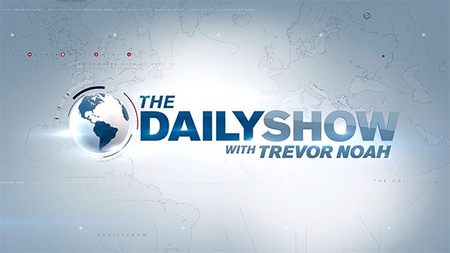
Misinformation | False or inaccurate information, especially that which is deliberately intended to deceive | Oxford English Dictionary
Publication Errors / Corrections | is an action, statement, or publication which is inaccurate or incorrect. Reputable news sources usually publish corrections or retractions. | Poynter.org
Satire | noun 1. the use of irony, sarcasm, ridicule, or the like, in exposing, denouncing, or deriding vice, folly, etc. | Dictionary.com
Propaganda | the spreading of ideas, information, or rumor for the purpose of helping or injuring an institution, a cause, or a person | Mirriam-Webster
Filter Bubble | A bias created when algorithms predict what results a user wants to see based on information about their location, previous searches, likes, and more. | Filter Bubble
Fake News | propaganda consisting of deliberate inaccuracies, misinformation, or hoaxes spread via traditional print and broadcast news meant to mislead or trigger an emotional response and reaction
Echo Chamber | An environment in which a person encounters only beliefs or opinions that coincide with their own, so that their existing views are reinforced and alternate ideas are not considered. | Oxford Dictionary
Notes:
Satire
What is Satire? Many of us recognize or watch shows like Saturday Night Live, The Daily Show, or even the newspaper/website The Onion. These are all examples of satire. Types of comedy shows or commentary that is defines as “irony, sarcasm, ridicule, or the like, in exposing, denouncing, or deriding vice, folly, etc.”
Can you think of some other shows? Or YouTube channels? Where they use humor, sarcasm, or irony to expose or point out flaws / inaccuracies / political mishaps. Satire ends up being an implicitly protected form of speech under the 1st amendment. See more info below from the linked source below.*
The reason Satire matters in our conversation is the way people interpret information. When someone speaks, you can hear the tone of voice. In Print or Online it is hard to decipher the tone.
In our social media driven, constantly connected world, people are frequently share, “like”, or repost without checking sources or the intent behind the story. This leads to people getting upset about stories that were Never designed to be taken seriously. Satire and Parody can sometimes very closely resembles real life stories.
Activity: The next slide has two separate stories. Just screen shots. Similar to how, they might be reposted on a social media platform. One is a Real story. One is a Parody story. Can you tell which one is real? Why? What strategies did you use?
Source - *Great source from James Walker Middle Tennessee State University, on the 1nst amendment and satire: https://www.mtsu.edu/first-amendment/article/1015/satire

Slide 5
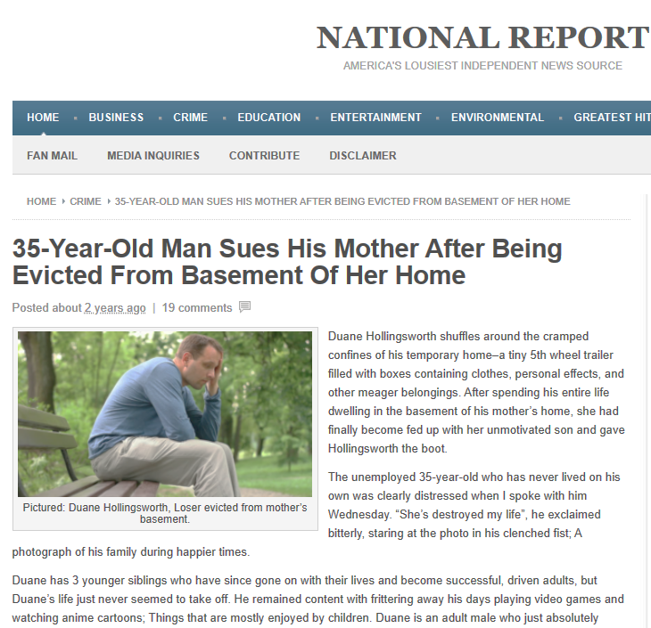
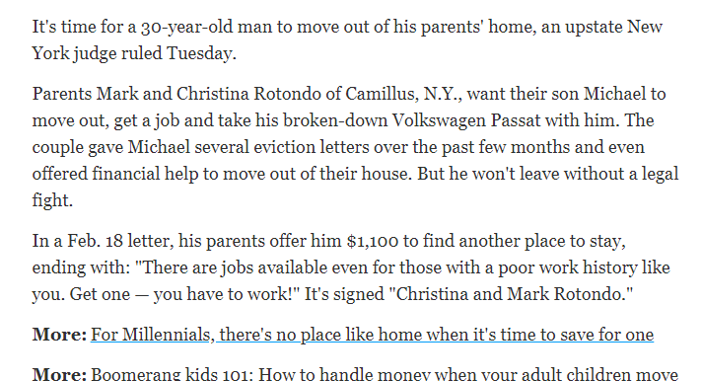
Notes:
Satire - Continued
Image source identification
-
-
-
The story on the left is from USA today about a very real court case in the USA in early 2018. The story on the right is a satire news from a UK source. A quick clue, the full title of the News Source is “National Report: America’s Lousiest Independent News Source”
With situations like this it is understandable that people have a hard time deciphering between real and comedy. And some people will take offense to these situations. The parody story above caused a major issue online when social groups and forums for mothers got upset and started boycotting the website.

Slide 6
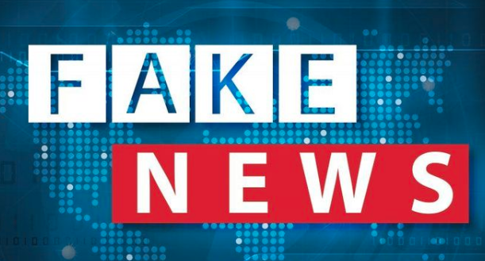
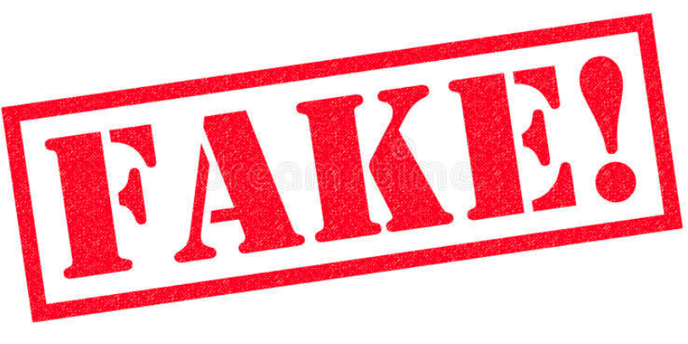
Filter Bubble | A bias created when algorithms predict what results a user wants to see based on information about their location, previous searches, likes, and more. | Filter Bubble
Fake News | propaganda consisting of deliberate inaccuracies, misinformation, or hoaxes spread via traditional print and broadcast news meant to mislead or trigger an emotional response and reaction
Echo Chamber | An environment in which a person encounters only beliefs or opinions that coincide with their own, so that their existing views are reinforced and alternate ideas are not considered. | Oxford Dictionary
Notes:
Fake News:
Back to definitions one more time. It is time to define FAKE NEWS. This is a term we have increasingly seen online in the last several years. At times, the term gets used for everything, from shutting down opponents to causing misdirection.
Fake News is “deliberate inaccuracies, misinformation, or hoaxes spread via traditional print and broadcast news, meant to mislead, trigger an emotional response, and reaction.”
Think back on the example title from the Misinformation Slide: Hottest Day On Record in Chicago City It was difficult to tell if there was an intent or a deliberate reason. What if the title instead read: Hottest Day On Record in Chicago City: 7 SPF Items to Buy Now.
In a case like this we can see some Red Flags, things to pause at. There is the data gap and there appears to be an interest from the site to get the consumers worried about a heat wave and encourage panic buying. Items they may not have picked up otherwise. This would be an example of Fake News that elicits an emotional response or makes a call to action.
Identification Game: Now with a better grasp of identification, lets try a simple visual identification game. Next Slide has 3 Images from electronically published news sources. Can you logically deduce which source is: Satire? Factual? Fake News?

Slide 7
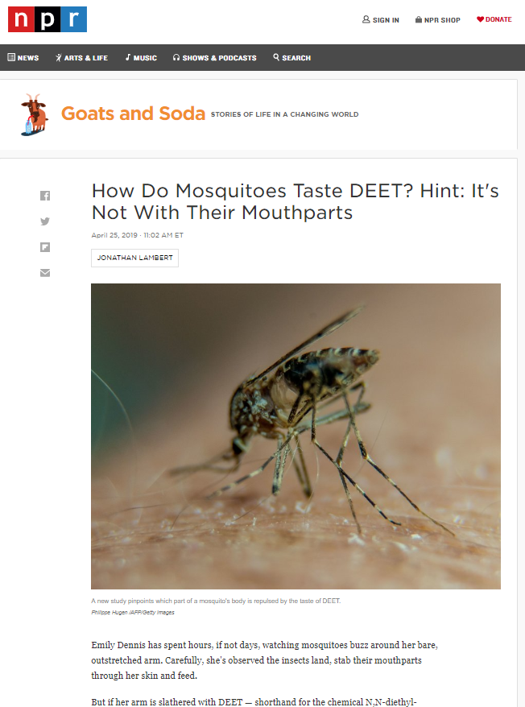
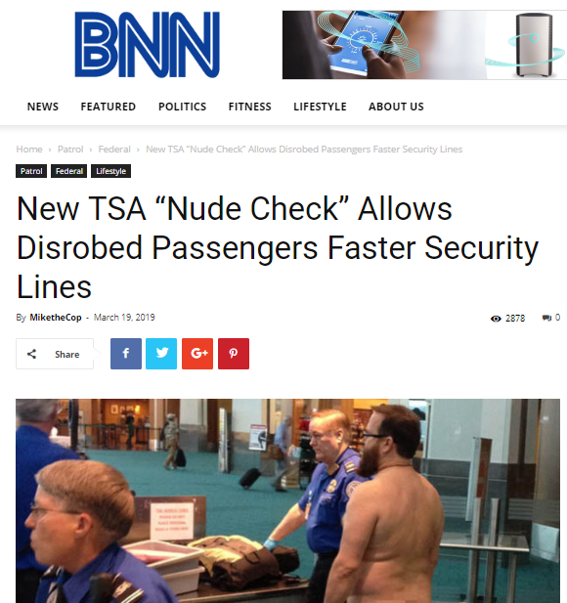
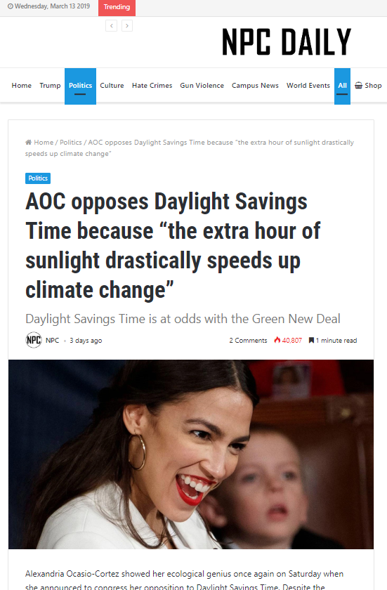
Which is Factual? Satire? Fake News?
Notes:
Which is:
Factual?
Satire?
Fake News?

Slide 8
Factual
Satire
Fake
Notes:
Were you about to guess correctly? What strategies did you use?
The BNN source (Blue News Network ) was satire. It is a pretty far fetched story. There are some important clues. The author of the piece is MiketheCop. Another important clue is checking their “About” section. As it turns out, they self identify as a satire source for cops and EMS personnel. And yet, BNN has been shared and posted by irate people blaming the fictional stories and situations.
The NPR ( National Public Radio ) Source is factual. Don’t let the Goats and Soda tag deceive you.
Lastly, the NPC Daily is Fake News. Misinformation debunking sites have been debunking their stories for years. The stories often have slants. Stories missing key elements. And no journalistic information on their “About Section”
-
-
-

Slide 9
Notes:
Class Content: The next two slides cover other types of Misleading Content and some Reason for Fake News.
It might seem like a lot of definitions, but these are important categories. There are a lot more types of Misleading Content. We are only going to cover two. Feel free to explore the rest at your leisure. Much of the content was created in partnership with other fact checking and information literacy sites. Links below*.
Two pieces I will point out from this slide are the “Error” category and the “Sponsored Content” category
Error: One important thing to understand is that mistakes in journalism happen. Sometimes news sources are reporting on facts very quickly as they roll out. Sometimes that happens without all the opportunity to double and triple check things. “Reputable” news sources will publish retractions or post on their news the corrections they made to the story.
Sponsored Content: This one is super tricky. To conduct research, Researchers, Universities, Labs, and testers need funding. Everything from funding for experiments, salaries, and publishing fees. This is normal. The problem is when they receive money show a shady source, or when the source has an invested interest in the results.
Example: Funding for a movie might be paid by Pepsi or Coke. They promote the product, the company pays for the film. No issues.
BUT what happens when there is a research team investigating the Effects of Fracking on Drinking Water, and it is discovered that one of the donors/funding agencies is a major fuel company. Would that be an issue? These type of situations happen.
Reputable research organizations disclose when there is a conflict of interest. Or when an investor owns part of the company and part of the story being covered.
Important to note: The more emotional response the piece of information has on you as a consumer, the more you should stop and ask if you are being ‘mislead’ or ‘informed’
Sources - *Media literacy sites and fact-checking sites like (Poynter https://www.poynter.org/) and Media Literacy for Citizenship (https://eavi.eu/ ) discuss factors that might motivate creating misinformation.

Slide 10
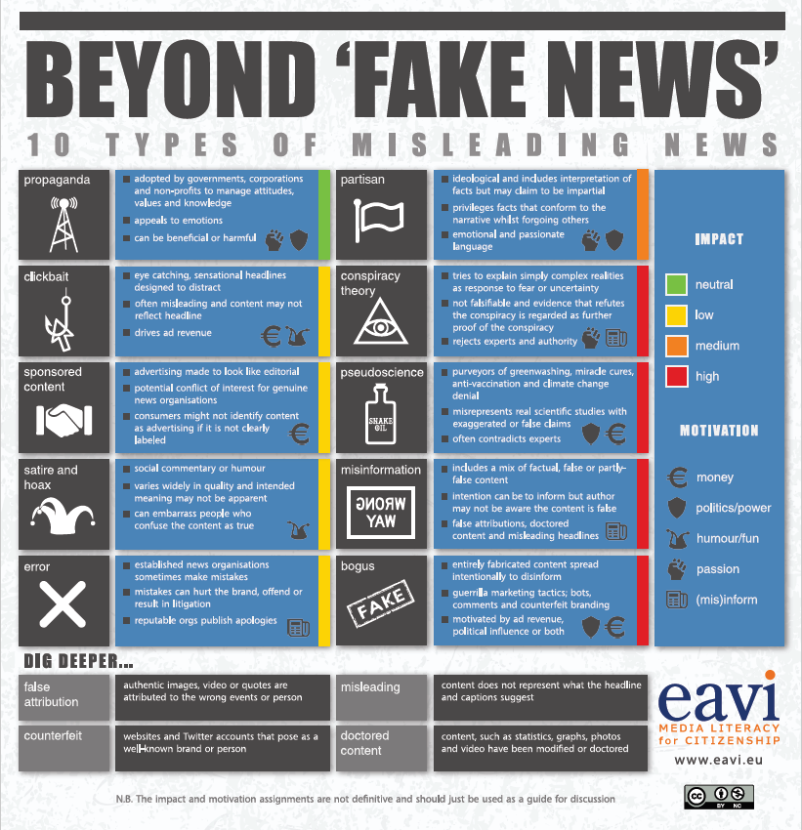
Notes:
Media literacy sites and fact-checking sites like (Poynter https://www.poynter.org/) and Media Literacy for Citizenship (https://eavi.eu/ ) discuss factors that might motivate creating misinformation.
Sometimes it is easy to dismiss Misinformation and Fake News as only something on Facebook OR only about politics. But the reality is that there is no shortage of reasons and motivations. On this graph from the EAVI explore a few of the same elements we discussed earlier. But this time with “motivation” layer they have added
This graphic illustrates some of the same terms discussed earlier, but also briefly discusses potential motivators for misleading content.
Media literacy sites and fact-checking sites like (Poynter https://www.poynter.org/) and Media Literacy for Citizenship (https://eavi.eu/ ) discuss factors that might motivate creating misinformation.
Many of us have run into sources that appear to be news-like or mimic as closely as possibly recognizable (or trusted) news sources. The motivations in cases like these might include: 1) change broad public opinion 2) sway political opinion 3) gain financially or 4) create confusion and discord.
Important to note: The more emotional response the piece of information has on you as a consumer, the more you should stop and ask if you are being ‘mislead’ or ‘informed’

Slide 11
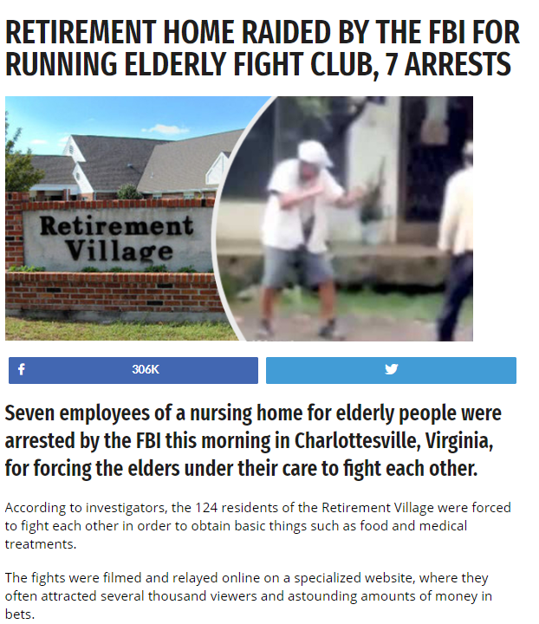
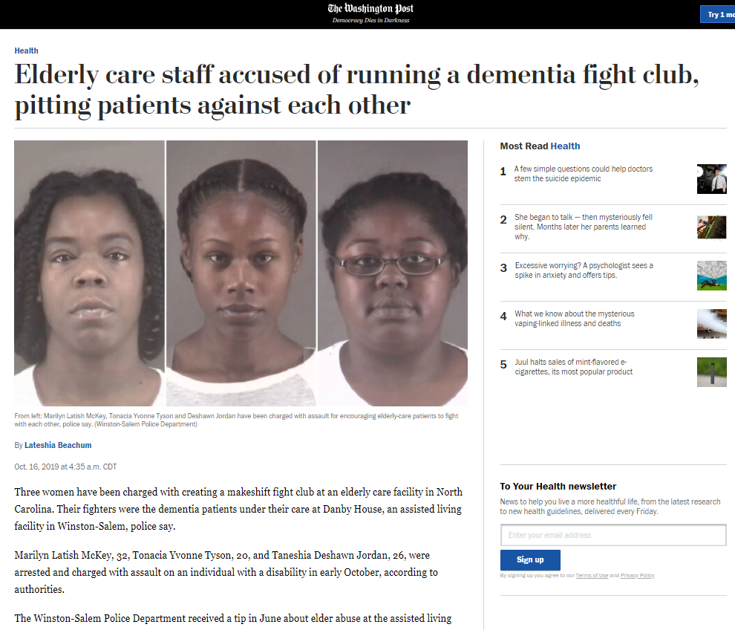
Which is Factual? Satire?
Notes:
One more Image source identification
Which one if a Real Story and which one is Satire

Slide 12
Notes:
Left story – Satire
Right story – Real story
Want to learn more about these. Want to pull up the story itself, but there is no link. No Worries. The next section talks about some strategies. In particular, how to fact check images.

Slide 13
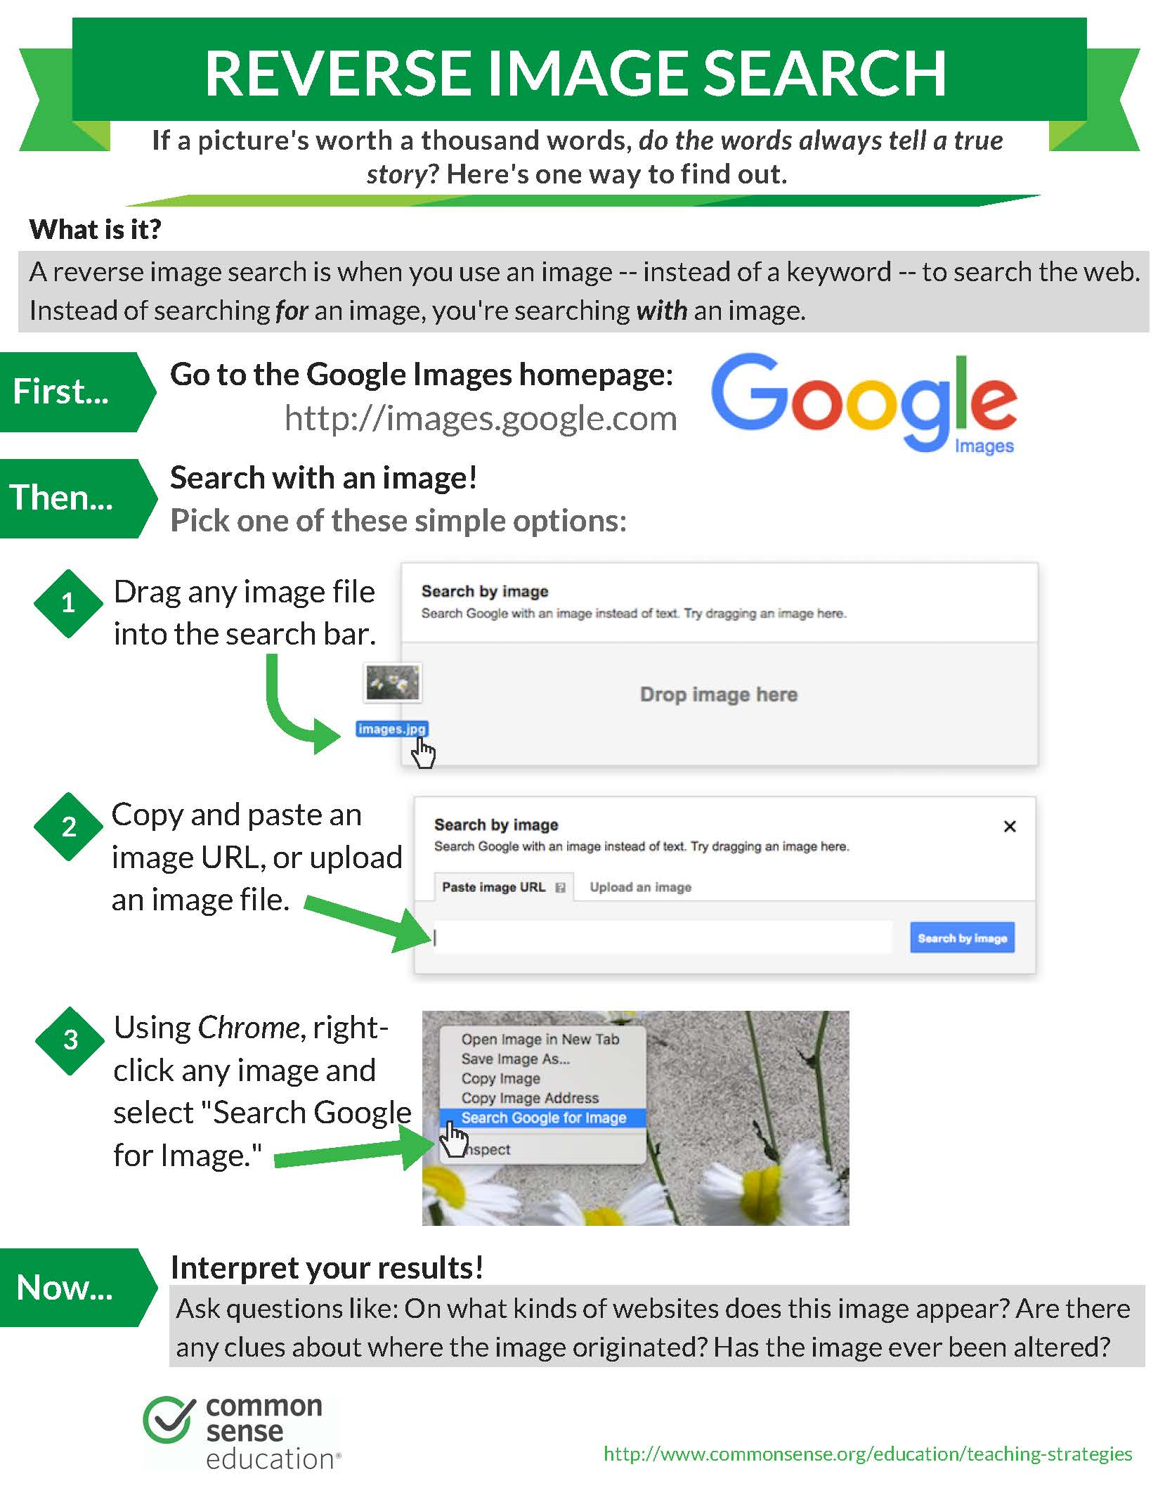
Fact Checking: Images
Images are powerful tools. They can:
Help sell a story
Create strong emotional response
Confirm a narrative
Create doubt
Notes:
Now let’s jump into fact checking some of these cases.
Images are powerful tools. There are so many phrases like: “believe what you see” or “I won’t believe it, till I see it with my own eyes.” And many others.
But images are easy to manipulate. It is important to learn how to fact check something that seems fishy. When that instinct tells you to check on it, you can always reverse image search.
Reverse image searches can be down in under a minute. They are fast. There should be no excuse for not trying it.
Steps similar to above: 1) use your pc’s snipping tool / screen shot/ or Command+Shift+4 on Macs, to capture the image you want to reverse search.
2) Drag it on to the search tool of your choice. In this case, images.google.com
3) Peruse and interpret your results. This is the tricky part that takes some sleuthing.
Hints:
Do you see several versions of the image? Slightly different crops of the same picture?
Do you immediately see a fact checking site ( Like Snopes.com or Politifact) with an article discussing that exact picture?

Slide 14
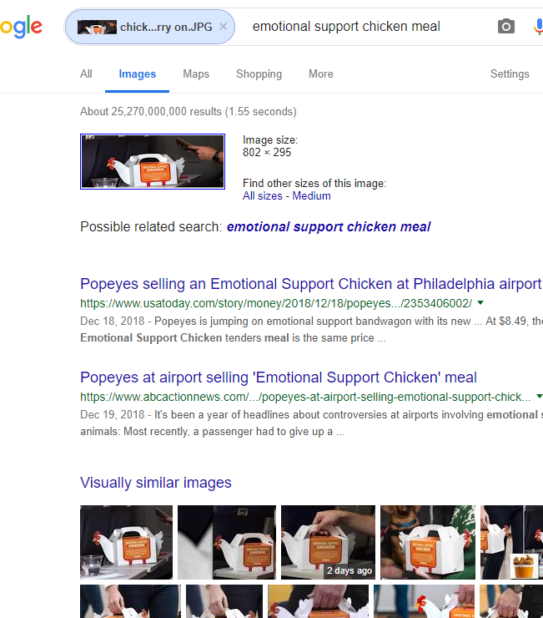
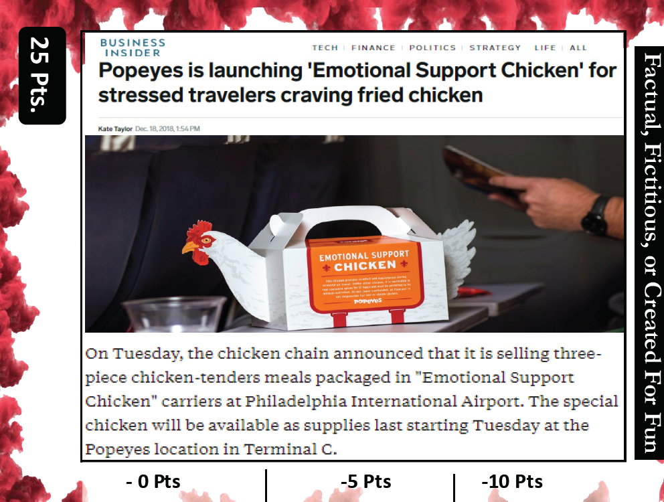
Lateral Searching:
Searching what other sources say about the research topic
Notes:
Example 1
You can use one of the images I have in the Library Services Factual, Fictitious, or For Fun card game. The card above is about a Popeyes marketing stunt to sell their meals in “emotional support chicken” containers.
Take the time to check for yourself. Snip the image from this slide. Save it. Drag it to google images. See the results.
When I searched, I got several results from USAToday and ABCnews with similar titles using the same picture. Makes sense! It was a marketing opportunity and their PR person sent photos to reporters.
If this enough for us, we can stop there. Or we can continue and verify that those other articles say the same thing about the chicken container. That the original story hadn’t skimped on the details.

Slide 15
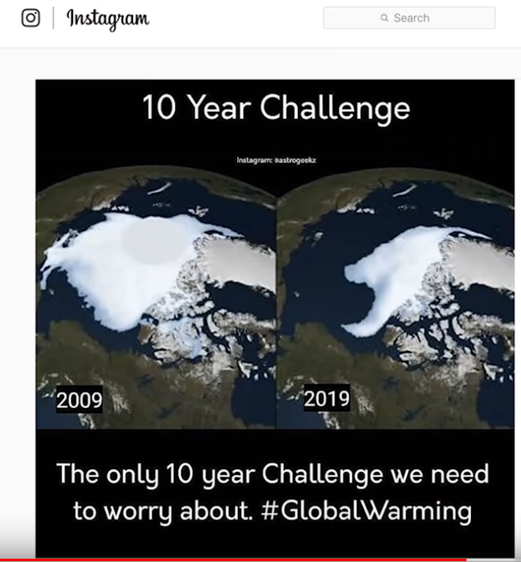
Check if images have been altered or context removed
Notes:
Example 2:
Another fantastic use for Reverse Image Searches is to verify is the image has been edited or taken out of context. Many of us see these kind of image and meme challenges. They prove a point….Or do they?
What happens when you reverse search this Instagram image search? Try it before moving to the next slide.

Slide 16
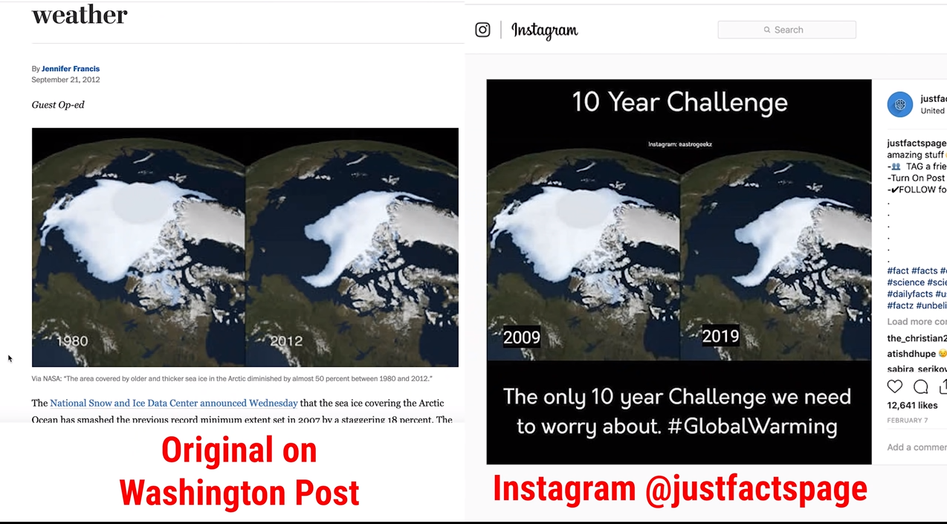
Notes:
In a YouTube video debunking fake posts the users illustrated this same example. When using a reverse search one can see that there was a itty bitty, slight, adjustment. Someone covered th original dates and put in new years!!!
The pictures are real. But the context is altered by the person adding 29 years to the one image. It undermines their efforts, and needs to be called out as an attempt to manipulate others.
Source: Youtube video form SmarterEveryDay (Why Your Newsfeed SUCKS - Smarter Every Day 212) interviewing Katy Byron - Poynter and Media Wise spokeperson
https://www.poynter.org/

Slide 17
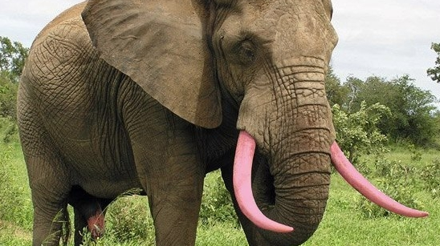
Samples
Notes:
Additional Examples:
Try some additional examples and see what kind of results you get from reverse searching.

Slide 18
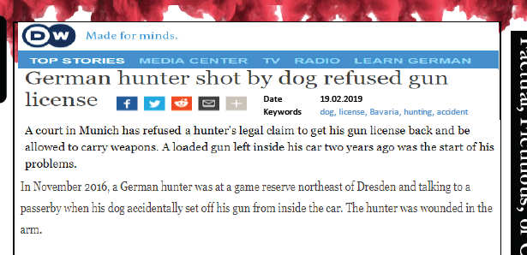
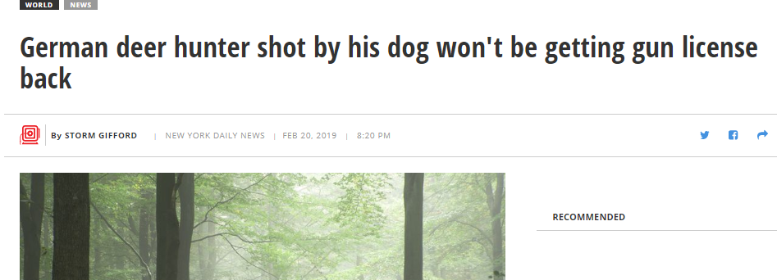
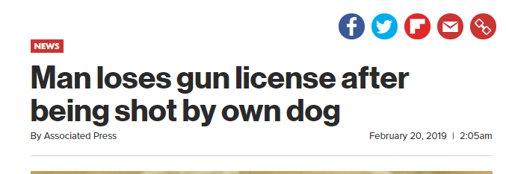
Fact Checking: Sensational Headlines
Strategies:
Check news aggregator for similar titles. How similar are they?
Is the source you have recycling the story from somewhere else? How much is new content.
Check a tool that lets you view different perspectives
Notes:
One of the last components to talk about is misleading headlines. The reality of the world is that Newspapers are in a business. They are in the business of getting you to see their stories. The problem arises when some blogs or sources intentional mislead, Clickbait, or swap content on users based on the geographic zones.
Sensational headlines are not new. This should not discourage you. We are in a wonderful internet era where it is easy to find out IF multiple stories that cover the same event.
A couple of strategies:
1) Lateral Searching. – This refers to searching multiple stories to confirm the same basic information. You are not digging deeper, you are going sideways and seeing if you find the same material in multiple directions. Using a strategy of multiple coverage, you can decipher if you are seeing something hyped up, or something factual with just an artistic flair.
2) About Sections - Digging into the About Sections on news sites if super important. It is also super important to know they have a “about section.” If a news site does not have an “About / About Us / More Info” type of section, should raise a red flag. These sections can tell you about them. What credentials. If they have any delineated journalistic standards.

Slide 19
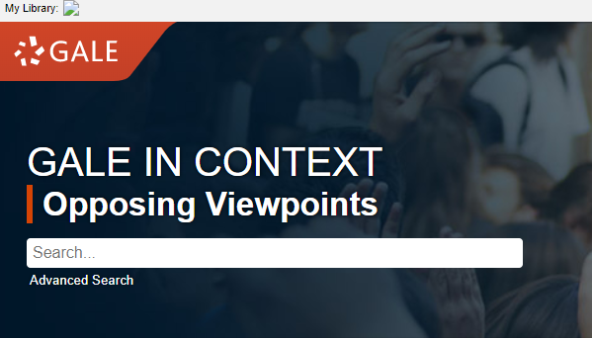
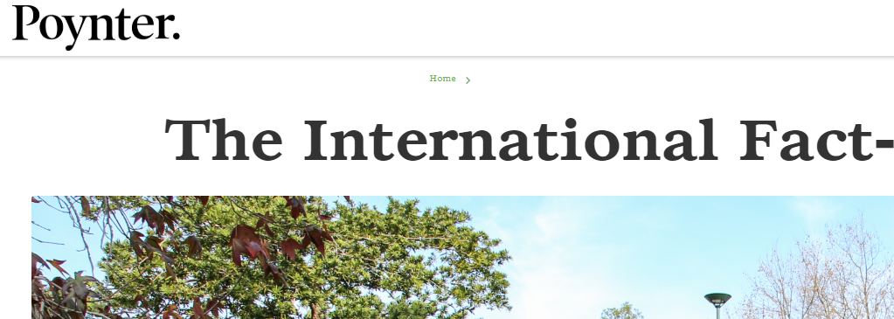
Fact Checking: Sensational Headlines
Fact Checkers
Different perspective
Notes:
If you still want to dig a little deeper. These are fantastic resources.
Good Luck, Good Hunting. And if you really feel in trouble, come find, e-mail, call, or send chat message to a librarian for help.

Slide 21
Questions?
Jorge León
Learning Outreach Librarian
jleon@pittstate.edu
More resources and tools: https://libguides.pittstate.edu/Misinfo
And for access to Librarians from anywhere use the chat service: https://axe.pittstate.edu/reference/ask-us.html
Notes:
If you have any questions or need clarification please contact Jorge León or Student Success Programs.
Jorge León
Learning Outreach Librarian
jleon@pittstate.edu
More resources and tools: https://libguides.pittstate.edu/Misinfo
And for access to Librarians from anywhere use the chat service: https://axe.pittstate.edu/reference/ask-us.html
Student Success Programs
Axe Library 113
studentsuccess@pittstate.edu
620-235-6578
Be sure to give us a follow on our social media accounts to keep you updated on Academic Success Workshops, study tips and more!
Facebook: PSU Student Success Center
Instagram: @psusuccess
Twitter: @psusuccess

