Slide 1

GUS Finance & Procurement Approvals
for Supervisors

Slide 2



GUS Finance & Procurement Approvals
for Supervisors
Stakeholder Meetings (2013) - Evaluate campus needs & develop rubric.
Vendor Demos (2014)
Partnership with Oracle (May, 2015)
System Configuration & Testing
Training, training & more training!
GO LIVE – OCTOBER 1, 2016

Slide 3

GUS Finance & Procurement Approvals for Supervisors
Approval Process
The approval process is an internal control procedure that encourages efficiency, compliance with laws, regulations, and policy, and seeks to eliminate fraud and abuse.

Slide 4
GUS Finance & Procurement Approvals for Supervisors
Current Accounting System
Unit – Authorized Signature
Responsibility for the transactions and balance in the Unit.
Users are delegated authority to use funding and approve transactions

Slide 5
GUS Finance & Procurement Approvals for Supervisors
Supervisor Approval
As a Line Manager – Supervisor you will need to approve…
Financial transactions for or initiated by someone you supervise may need your approval.
  Employee reimbursements including travel.
  Employee Pcard (BPC card) transactions.
  Purchase Orders or Invoices paid to a 3rd Party Vendor initiated by an employee you supervise.
GUS Cloud

Slide 6
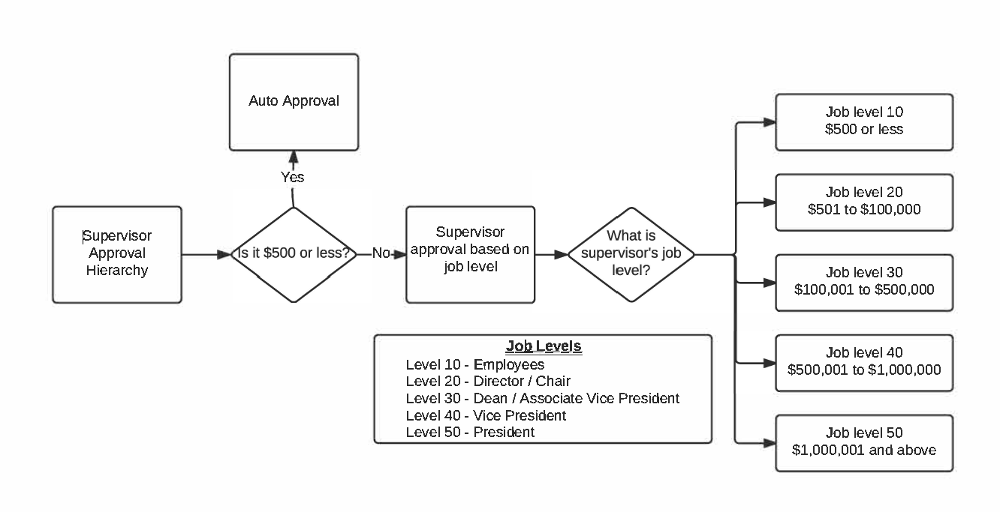
GUS Finance & Procurement Approvals for Supervisors
Transaction Approval Matrix for the Expenses Module – Payments to Employees for travel and other miscellaneous reimbursements, and Pcard transactions for employee cardholders.
SUPERVISOR HIERARCHY
Example: Stacy Wolownik submits a Pcard Expense Report (Expenses module) for John Patterson in the amount of $1,200.
Approvals:
Employee (Requester) John Patterson (Vice President at Job Level 40)
Supervisor Approval Steve Scott (President at Job Level 50)

Slide 7
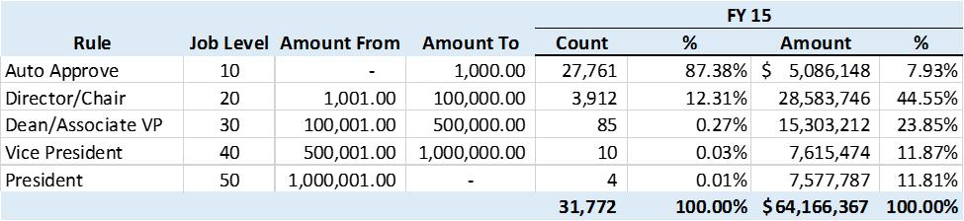
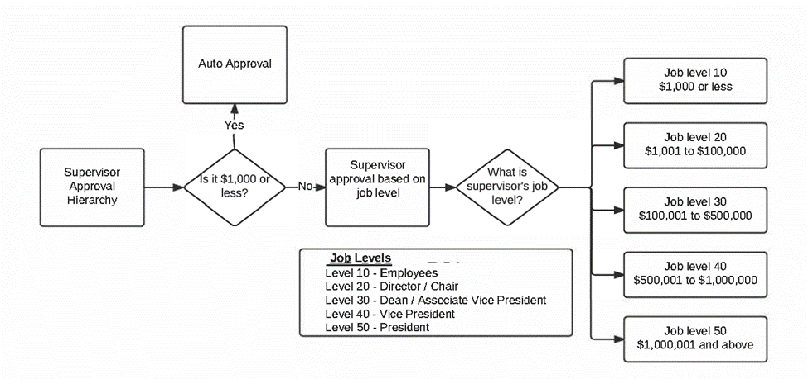
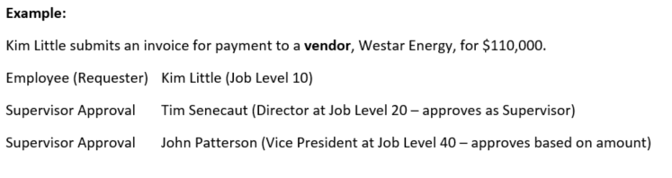
GUS Finance & Procurement Approvals for Supervisors
Transaction Approval Matrix for the AP/Procurement Module – Payments to Vendors via Purchase Order, Invoice, or Punchout.
SUPERVISOR HIERARCHY

Slide 8
GUS Finance & Procurement Approvals for Supervisors
Expenses Module
(Pcard, Employee Travel & Other Reimb.)
Business Office Pre-Audit
PSU Foundation Approval
(Foundation funding)
Accounts Payable Module
(Supplier Payments)
Supervisor Approval Hierarchy
Business Office or PSU Foundation Audit
(Based on Funding)
Procurement Module
(Purchase Order)
Supervisor Approval Hierarchy
PSU Foundation Approval
(Foundation funding)
Supervisor Approval Hierarchy
Cost Center Approval
(Based on Funding)
PSU Foundation Board Approval
( Based on Funding & > $10,000)
Professional Development Funds Approval
(Based on Funding)
Professional Development Funds Approval
(Based on Funding)
PSU Foundation Board Approval
(Based on Funding & > $10,000)
Business Office Pre-Audit
PSU Foundation Board Approval
(Based on Funding & > $10,000)
Professional Development Funds Approval (Based on Funding)
Purchasing Office
Notes:
Supervisor Approval is one stop in the business process of a payment transaction.

Slide 9
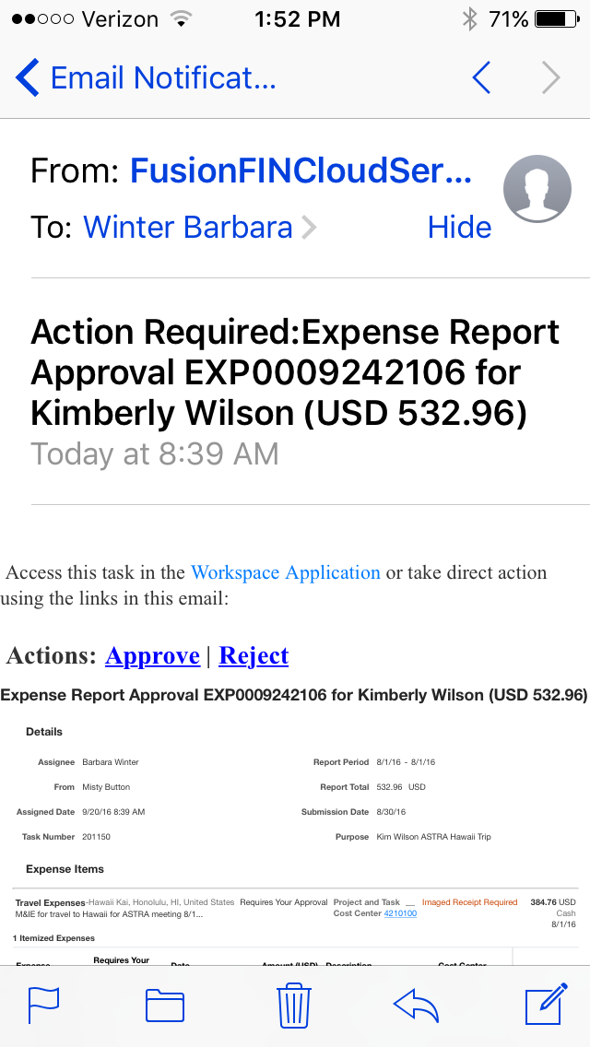
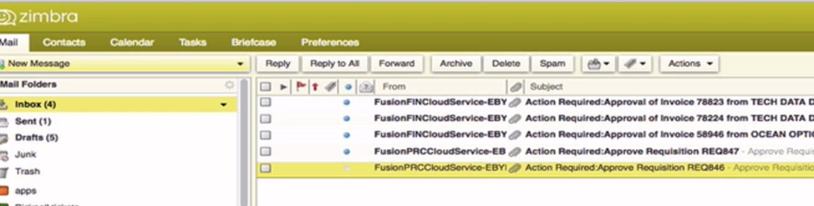
GUS Finance & Procurement Approvals for Supervisors
Via Email (computer or mobile device)
FusionPRCCloudService…
FusionFINCloudService…
Approving Expenses and Procurement Requests by email in GUS Cloud – Line Manager Training

Slide 10
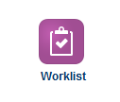

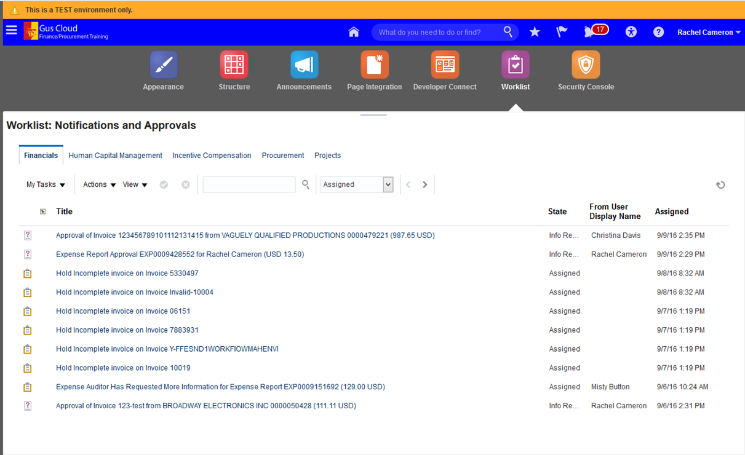
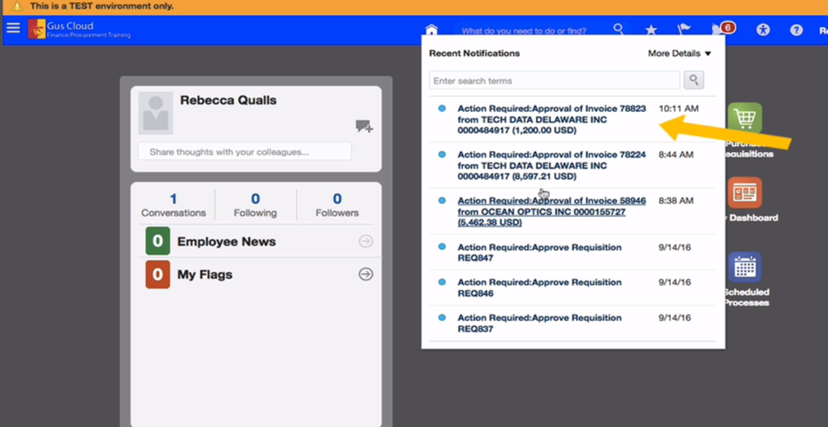
GUS Finance & Procurement Approvals for Supervisors
Within GUS Cloud
or
Approving Expenses and Procurement in GUS Cloud – Line Manager Training

Slide 11
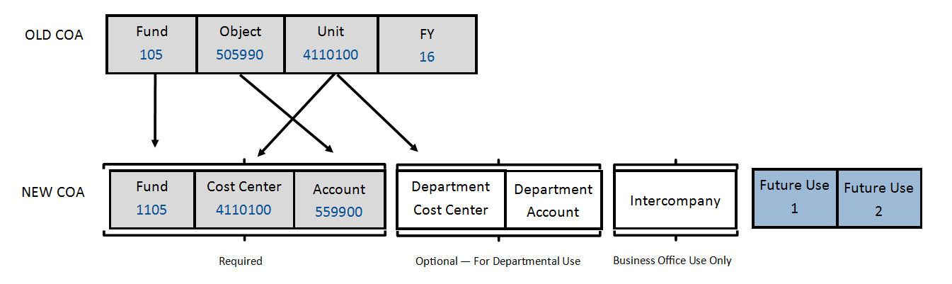
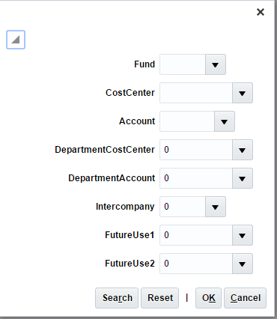
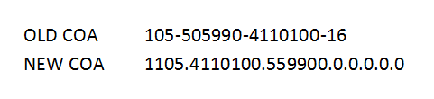
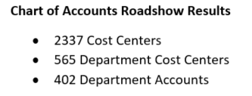
GUS Finance & Procurement Approvals
for Supervisors
Chart of Accounts
Mapping OLD to NEW
Each block in the Chart of Accounts is a ‘Segment’.

Slide 12

GUS Finance & Procurement Approvals for Supervisors
Timely approval of transactions is critical for prompt payment to our Suppliers and Employees!
If you are unavailable to do your Approvals, then policy has been developed to guide you on when it is appropriate to delegate your approvals to another employee.

Slide 13
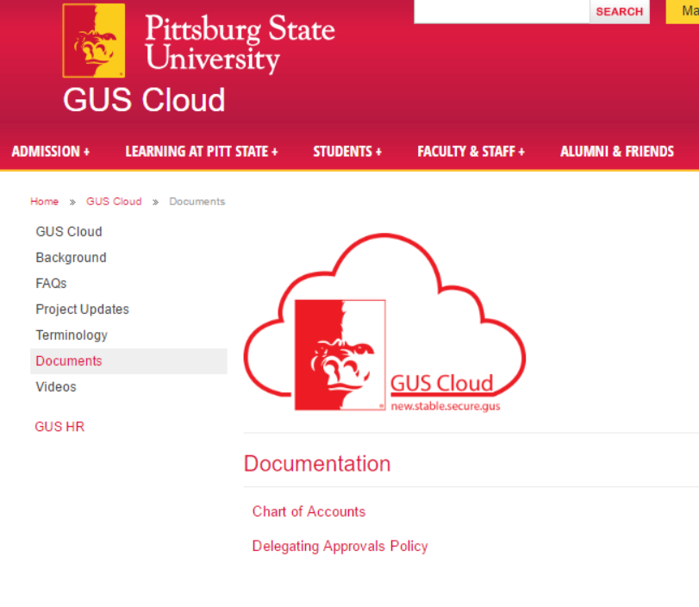
GUS Finance & Procurement Approvals for Supervisors
Delegating approvals should provide only temporary continuity of business while the approving employee is unable to complete approvals because of vacation, medical leave, etc.
Approvals may be delegated to employees trained in GUS Cloud and at a position level that is the same or higher, and in no instance more than one level below the employee delegating their approvals. In no instance would it be appropriate for a delegate to be a student or graduate assistant, or an administrative employee who is preparing financial transactions.
The following are examples of an employee delegating their approvals that we believe appropriate:
Chair to Department Faculty Member
Dean to Associate Dean/Chair/Director
Director to Assistant Director
Vice President to Associate Vice President/Dean/Director
Department Admin to Department Admin (Time & Labor and Absence approvals only)

Slide 14
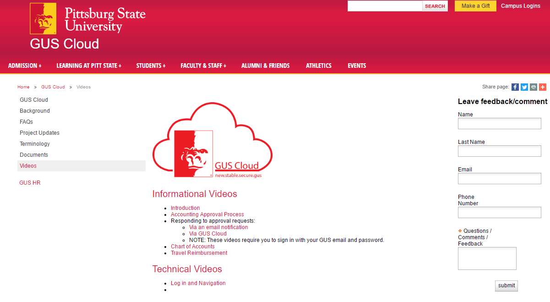
GUS Finance & Procurement Approvals for Supervisors
Resources
GUS Cloud website
www.pittstate.edu/guscloud
Yammer - GUS Cloud Finance and
Procurement group.
Email us….
Finance Support:
GUSFinance@pittstate.edu
Procurement Support:
GUSProcurement@pittstate.edu
General Support:
geeks@pittstate.edu

Slide 15

GUS Finance & Procurement Approvals for Supervisors

