Slide 1
Transform Teaching and Learning by Unpacking Privilege
Brenda J. Allen, Ph.D.
October 20, 2015
Notes:
45 minutes

Slide 2
Why Transform Teaching and Learning?

Slide 3
Privilege
Advantaged status based on social identity

Slide 4
Unpacking Privilege
server403.webhostingpad.com
Notes:
An invisible weightless knapsack of special provisions, maps, passports, codebooks, visas, clothes, tools and blank checks which can be counted on daily but about which the person was ‘meant’ to remain oblivious
From Peggy McIntosh, White Privilege

Slide 5
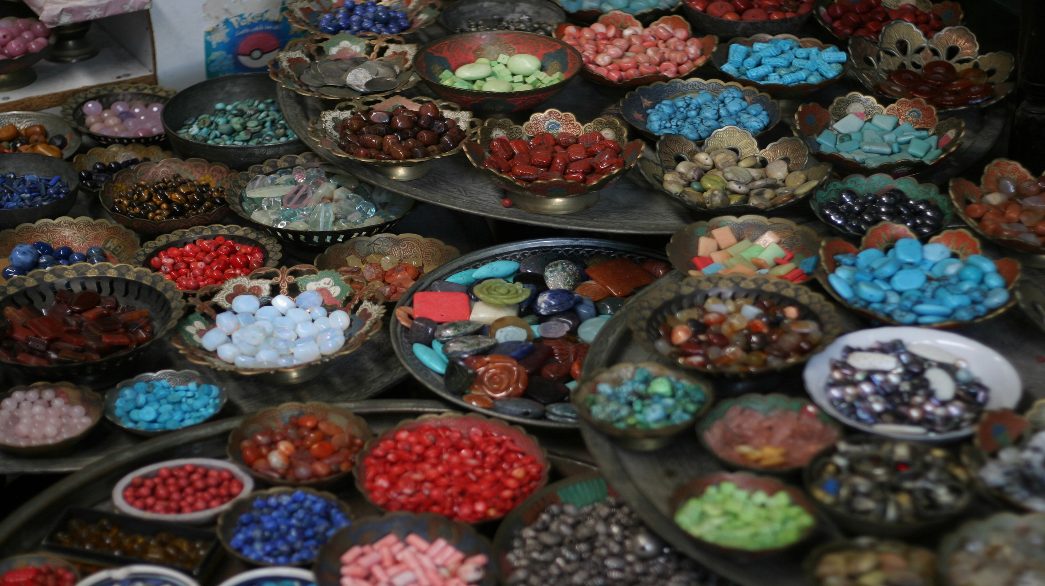
Privilege Beads Exercise
en.wikipedia.org
Notes:
en.wikipedia.org

Slide 6
Class Privilege
I can be sure that my social class will be an advantage if I seek medical or legal help.
I am reasonably sure that I or my family will not have to skip meals because we cannot afford to eat.
I don’t have to rely on public transportation to travel to work or school; I can afford my own vehicle.

Slide 7
Ability Privilege
I can assume that I will easily have physical access to any building and all areas within that building.
I have never been taunted, teased, or socially ostracized due to a disability.
I don’t have to decide whether or not to disclose that I have an invisible disability to an employer or teacher.

Slide 8
Religion Privilege
I can assume that I will not have to work or go to school on my religious holidays.
I do not worry about consequences of disclosing my religious identity to others.
Implicit or explicit references to religion where I work or go to school conform to my religious beliefs.

Slide 9
Sexuality Privilege
I can move about in public without fear of being harassed or physically attacked because of my sexuality.
I can go for months without me or anyone else referring explicitly to my sexuality.
People don't ask me why I “chose” my sexual orientation.

Slide 10
Race Privilege
In all of my educational experiences, curricula have taught about my race in positive ways.
When I shop, I feel assured that store employees will not follow me or closely watch me because of my race.
I am never asked to speak for all the people of my racial group.

Slide 11
Sex/Gender Privilege
If I have children and a successful career, few people will ask me how I balance my professional and personal lives.
Major religions in the world are led mainly by people of the same sex as I am.
I do not have to think about the message my wardrobe sends about my sexual availability.

Slide 12
Discussion

Slide 13
Recommendations

