Slide 1
Difference Matters and Pedagogy
Brenda J. Allen, Ph.D.
October 20, 2015

Slide 2
Difference

Slide 3
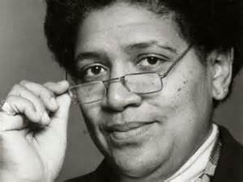
It is not our differences that divide us. It is our inability to recognize, accept, and celebrate those differences. Audre Lorde

Slide 4
Difference = Social Identity*
Group oriented
Membership (perceived by others and/or self)
Meaningful to self and/or others
Identifiable (labeled)
Learned
Assigned
Power-laden
*Tajfel, H., & Turner, J. C. (1979). An integrative theory of intergroup conflict. In W. G. Austin & S. Worchel (Eds.), The social psychology of intergroup relations (pp. 33–47). Monterey, CA: Brooks/Cole.

Slide 5
Matters

Slide 6
Why Difference Matters
Population
Societal changes
Persistent inequities
Potential for + change
Challenges to address

Slide 7
Challenges
Denial
Simplified categories
Focus on “other”
Difference = problem
Diversity as separate issue

Slide 8
Why Higher Ed Matters
Source of constructing identities
Site where we encounter differences
Context for change*
*Bowen, W. G. & Bok, D. (1998). The shape of the river: Long-term consequences of considering race in college and university admissions. Princeton: Princeton University Press.

Slide 9
Challenges in Higher Ed
Track “diversity by the numbers”
Define diversity narrowly
Focus on “other”
Relegate responsibility
React rather than being proactive
Limit diversity education to students

Slide 10
Pedagogy
methods and practices of teaching; the art and science (and craft?) of teaching

Slide 11
What is inclusive pedagogy?
Attitudes and behaviors which communicate to ALL students that you welcome them to the course and regard them as capable members of a learning community, with strong potential to succeed.
Notes:
B

Slide 12
Factors of Inclusion
Your self awareness and reflexivity
Course content
Your knowledge of your students
Classroom climate
Your teaching behaviors and attitudes
University of Michigan Center for Research on Teaching and Learning http://www.crlt.umich.edu/gsis/p3_1
Notes:
Difference matters for each of these.

Slide 13
Self awareness
Reflection Questions
Notes:
What is your philosophy of teaching? How does your philosophy incorporate inclusive pedagogy? Values the assets students bring to the classroom
Be mindful of YOURSELF:
Honesty is the best policy, with students and yourself
Learn to share authority
Listen actively
Value feedback
Have consistent awareness; education is dynami What assumptions do you hold about
Student identity
Your identity
Learning
Authority
Your own knowledge
Intelligence
Know your own hot buttons/biases and what will make your mind stop working.
your preferred learning style?
Your attitude toward learning; teaching
age attitudes toward yours and your students? examine his or her own racial or cultural biases in preparation for teaching:
1. How do your own experiences, values, beliefs, and stereotypes influence your knowledge and understanding of groups that are racially different from your own?
What assumptions do I make about different student groups?

Slide 14
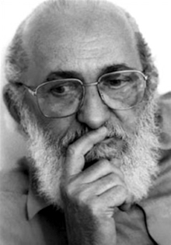
I cannot be a teacher without exposing who I am.
Paulo Freire

Slide 15
Course Content
Reflection Questions
Notes:
Alter and be conscientious of your curriculum:
Include texts, media, and supporting materials that
Represent varying demographics
Explore multiple histories
Encourage students to consider their own and others’ identities
Allow for in- and out-of-class investigation of critical thoughts
Content AND how you assess learning. Whose voices, perspectives, and scholarship are being represented?
How are the perspectives and experiences of various groups being represented?
examples

Slide 16
Knowledge of Your Students
Reflection Questions
Notes:
What are the demographics at your institution? In your department? In your classes? How do you get to know the students on your campus? In your department? In your classes? What resources exist to help all of your students succeed? Especially underrepresented?

Slide 17
Classroom Climate
Reflection Questions
Notes:
. . .instructors and students create and sustain an environment where everyone feels safe, supported, and encouraged to express her or his views and concerns.
Give more time for responses
Ask opinions, verbally and nonverbally
Vary participation
Allow students to determine format for homework
Use different forms of texts and media in the classroom
Take the spotlight off your ideas and talk less.

Slide 18
Your Behaviors & Attitudes
Reflection Questions

Slide 19
Recommendations
Deepen your commitment
Focus on factors of inclusion
Identify & implement promising practices
Develop and reward inclusion standards

Slide 20
Recommendations
Identify, create, & share RESOURCES
Collaborate with faculty, students, and staff
Engage in professional development
Others?

Slide 21
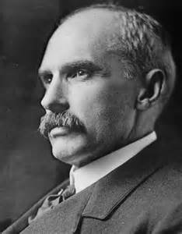
Who dares to teach must never cease to learn. John Cotton Dana

Slide 22
Resources
Difference Matters Website
www.differencematters.info
Harvard Implicit Association Test
https://implicit.harvard.edu/implicit
UC Berkeley – Creating Inclusive Classrooms http://mep.berkeley.edu/classroom

Slide 23
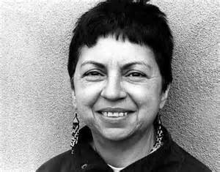
I change myself, I change the world.
Gloria Anzaldua

