Slide 1





Academic Affairs Strategic Visioning Task Force
Bryan Setser, Principal rpk GROUP
Pittsburg State University Sessions
January 28-29, 2019
www.rpkgroup.com
.

Slide 2



Don’t ask students what they want to be, ask them what problems they want to solve - Casap

Slide 3

Site Visit Objectives for PSU Collaboration
Understand how to view institutional programs as an ROII portfolio
Learn best practice for applying an ROII lens to the academic portfolio when deciding on program investment, innovation, and reallocation
Discuss best practice for creating engagement with faculty and academic leadership around the business model for Pittsburg State
Act with new tools to create sustainable innovation
3
www.rpkgroup.com
rpk GROUP. All rights reserved.

Slide 4
January 28-29, 2019 Site Visit Agenda
PSU Culture and People Experiences
Campus Interviews
President’s Council
Data Team Meetings
Faculty Senate
Provost Leadership Council
Focus Groups
4
www.rpkgroup.com
rpk GROUP. All rights reserved.

Slide 5
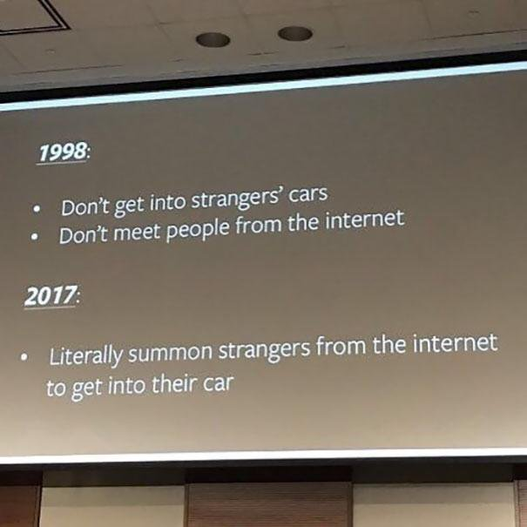
Why are today’s business models different?
Why are today’s business models so different?
5

Slide 6
How Do We Create Game Changer Student Value in a Dynamic Market?
  Market
    What do our students need?
  Mission
    What are we (or could we be) good at that responds to these needs?
  Margin
    How do we create student value AND a sustainable financial model?
Mission
Market
Margin

Slide 7
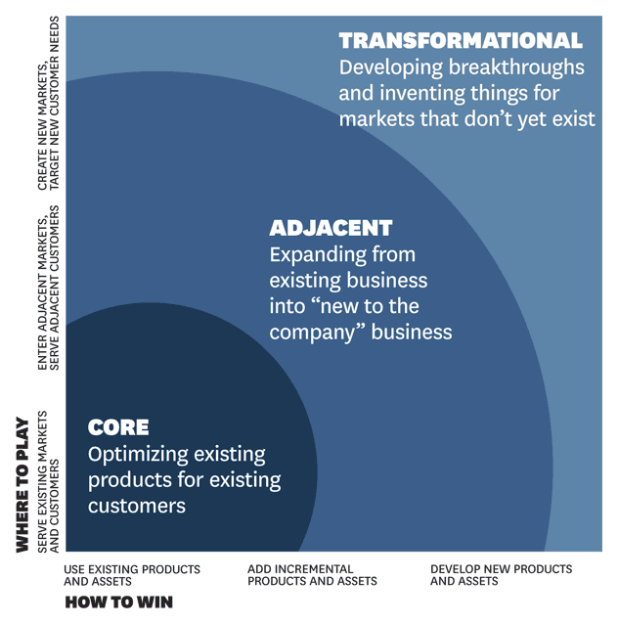
A Shift from Core PSU Offerings to Adjacent and Ultimately Transformational Programs/Services
Courses + Degrees
Credential + Certification Portfolio
Up skill Suite of Faculty-led Services Powered by AI Adjuncts for Community Colleges
7

Slide 8



Move Towards A Shared Future for Vision for Academic Affairs
We’re going to save 100,000 lives in 5 years – Berwick
We’re going to graduate 3,000
First Generation College Students by 2025
www.rpkgroup.com

Slide 9
rpk Roles and Responsibilities for Strategic Academic Visioning
Support the Provost
Co-lead the steering and data teams
Develop a communications plan and cadence of supports
Play provocateur to the stratetgic visioning process
Manage the project and change
Empower people and build capacity
Accomplish milestones and goals
Help tell the story of change and innovation for outcomes
9
www.rpkgroup.com
rpk GROUP. All rights reserved.

Slide 10
Project Goals
Categorize programs for enhancement, maintenance, or monitoring using objective criteria as one component of the evaluation process
Identify opportunities for re-organization within the Division of Academic Affairs in order to optimize efficiency and enhance delivery of educational programs
Identify possible new programs, with an emphasis on those with potential for enrollment growth and revenue generation
10
www.rpkgroup.com
rpk GROUP. All rights reserved.

Slide 11
Milestones
          Project Team Structure, Planning, and Communications – January 2019
          Site Visit and Kick-off Meetings – January 27-29, 2019
          Data Collection + Interviews – 8 weeks
          Data Analysis + Focus Groups - 8 weeks
          Steering Team Meetings every two weeks during data collection and analysis
          Draft Findings and Midpoint Meeting - Approximately 4.5 months after project start (late March/Early April) –Design Sessions
          Revisions and Additional Data Analysis and Findings - 2 weeks
          Draft Recommendations - 2 weeks
          Final Report and Presentation - 2 weeks (May/June)
11
www.rpkgroup.com
rpk GROUP. All rights reserved.

Slide 12
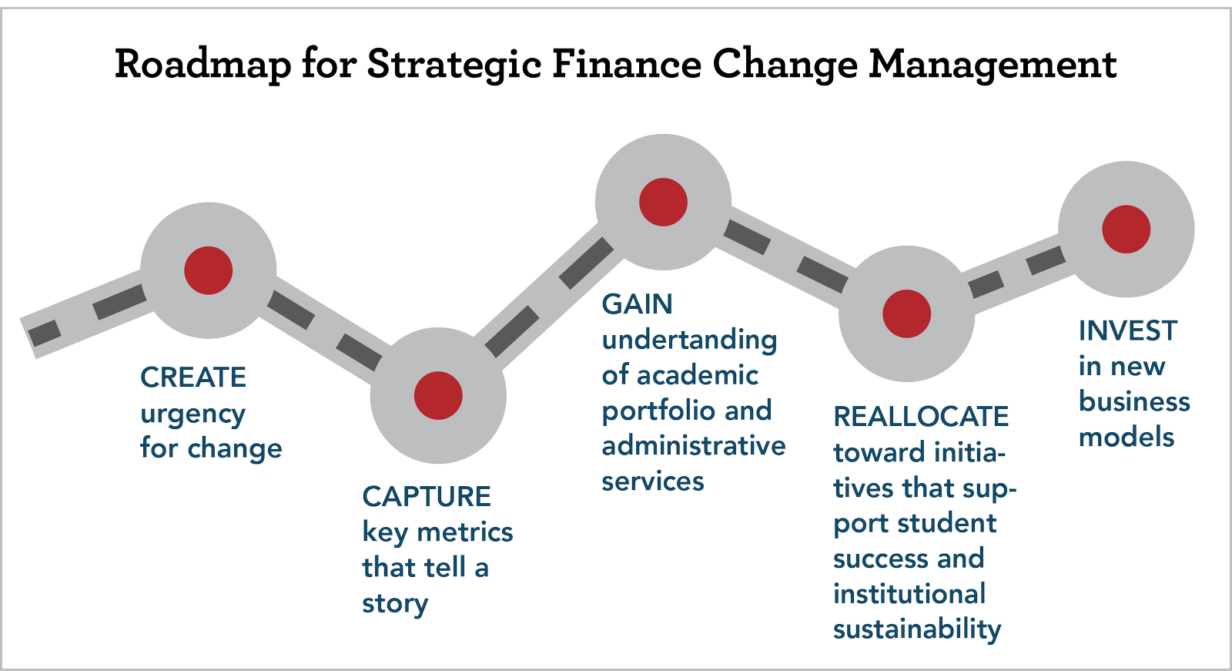
Change moves at the speed of trust - Covey
12
www.rpkgroup.com
rpk GROUP. All rights reserved.

Slide 13

Field Guide Exercise #4: I like, I wonder, I question
Stanford University D School Exercise: I Like, I Wonder, I Question
Notes:
Rick – 7-13

