Slide 1
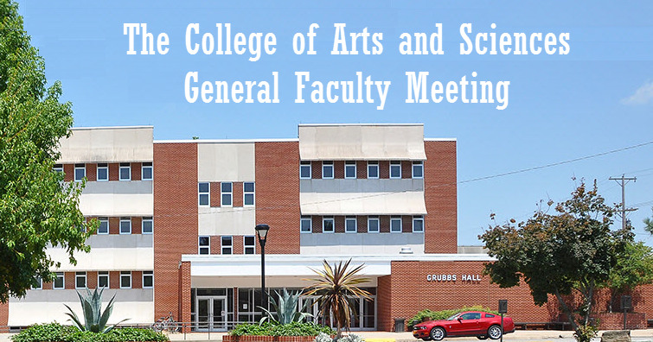

Slide 2
The College of Arts & Sciences
“State of the State” in the College of Arts & Sciences AY 2015-2016
Interim Dean, Mary Carol Pomatto

Slide 3
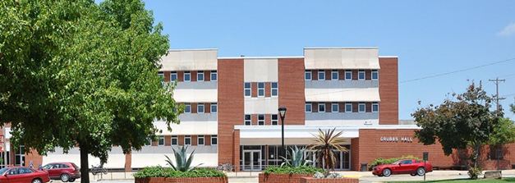
The College of Arts & Sciences Mission
Through our more than 50 undergraduate major, minor and graduate programs in 11 departments, one school and three interdisciplinary units, as well as our participation in the university’s general education program, we prepare students for global citizenship so they become life-long learners leading meaningful and purposeful lives, contributing to their communities and fully participating in the democracy.

Slide 4
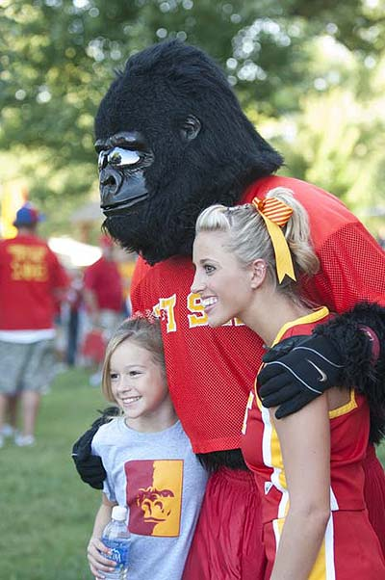
The College of Arts & Sciences Goals
Recruit and retain students
Enhance/encourage a culture of research and discovery
Enhance engagement and interaction with external stakeholders
Embrace and utilize emerging technologies
Recruit and retain faculty, obtain resources and practice sound fiscal management
Institutionalize environmental sustainability

Slide 5
The College of Arts & Sciences – Fall 2015
120 Unit faculty; 31 FTT faculty
11 chairs/directors
Students – 2,356 of 7,244 Majors both Undergraduate and Graduate (32.52% of PSU total)
Credit Hours Produced by the college – 97,344 of 196,380 (49.5% of PSU total)
Scholarships, grants and awards (all levels) – Over $1,000,000

Slide 6
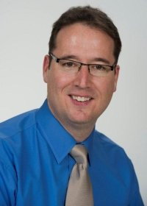
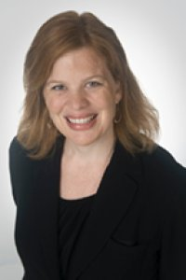
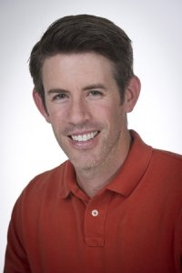
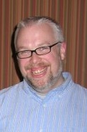
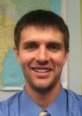
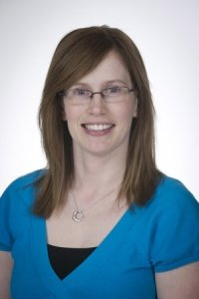
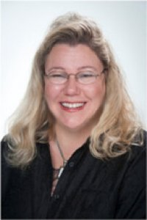
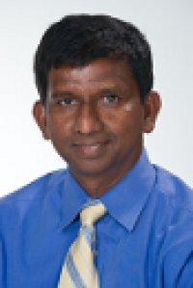
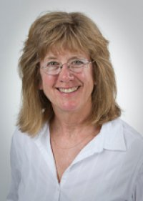
Promotions and Sabbaticals FY 2016
University Professor
Professor
Associate Professor
Todd Hastings
Stella Hastings
Phillip Harries
Jamie McDaniel
Grant Moss
Mandy Peak Bryan
Sabbaticals
Congratulations!
Todd Hastings
Cynthia Huffman
Ananda Jayawardhana
Virginia Rider
Khamis Siam
Sabbaticals

Slide 7
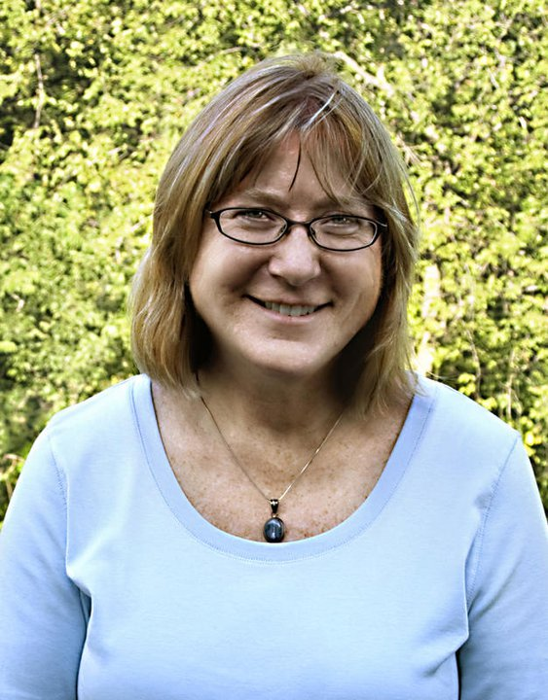
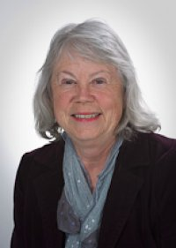
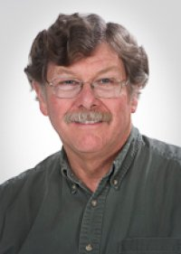
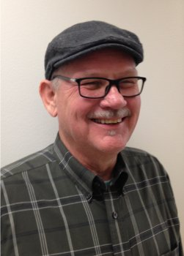
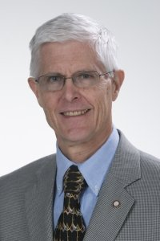
To those retiring
With Gratitude and Best Wishes for the Future
Kathleen De Grave
English and Creative Writing
English & Modern Languages Dept.
Cynthia Ford
Biology
Biology Dept.
Steven Ford
Zoology
Biology Dept.
Paul ‘Skip’ Morris
English
English & Modern Languages Dept.
Paul Zagorski
Political Science
HPSS Dept.

Slide 8
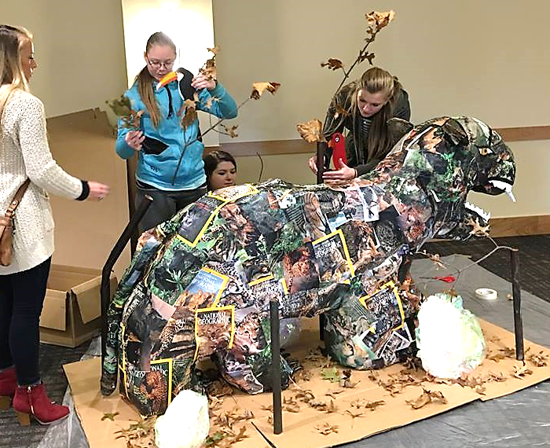
Art
Faculty Portico Bowman received a Post-Graduate Certificate in Creative Writing from The School of Writers at the Humber Institute for Advanced Learning and Technology in Toronto, Canada.
Student Jacqueline Denton participated in an internship with the painter Oliver Hibert. This culminated in a gallery exhibition of her work as well as his in Phoenix, Arizona.
Faculty James Oliver was awarded a grant through the SEK Art Fest that provided the opportunity for his Mural Painting class to execute a public mural for downtown Pittsburg.
Hand Lettering for Comics & Illustration class’ participation in the Kansas People’s History Project. Their work will be part of a traveling exhibition.

Slide 9
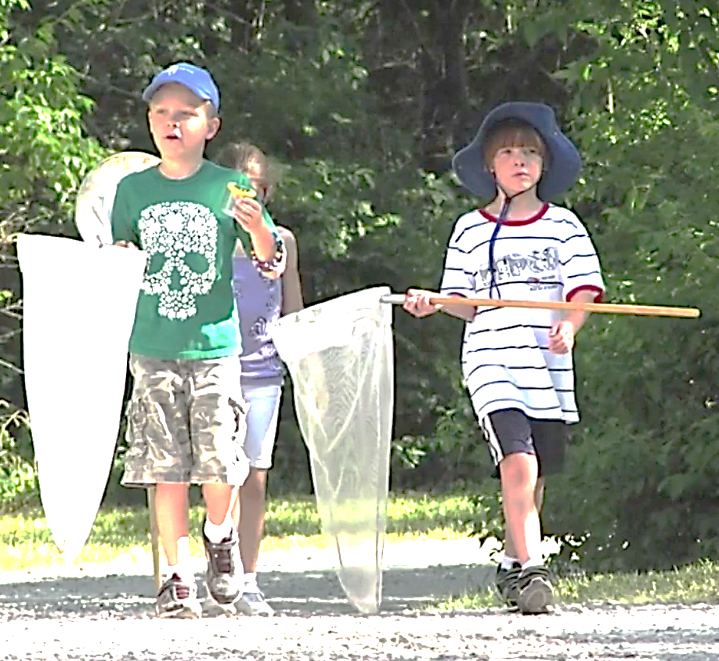
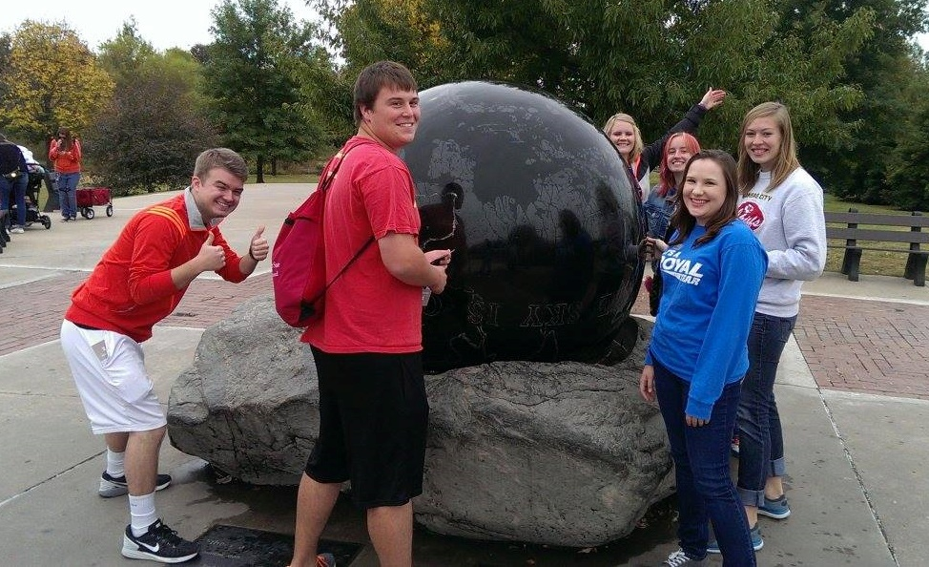
Biology
Ten students plus recent biology graduates are traveling to Glacier Bay National Park Summer 2016 for a study away trip.
The Biology Department Nature Reach Program raised $40K and completed 158 presentations, reaching 4400 people in 20 different communities in three states.
Student Travis Burrows will be working with the USFS working on the sage grouse program during Summer 2016.
Prehealth students experienced a once in a lifetime opportunity with a panel of eight physicians and graduates of PSU. Students interviewed the panel on definitions of success and other topics. It was a special opportunity to appreciate the dedication, humor and professionalism shared by our physician graduates.

Slide 10
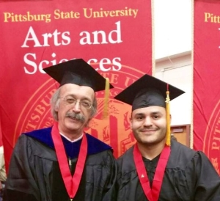
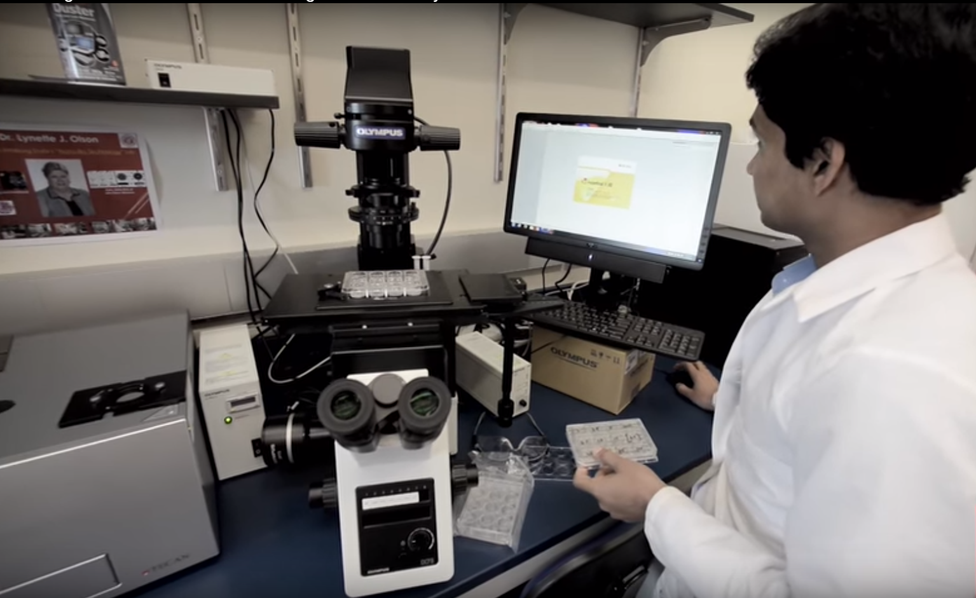
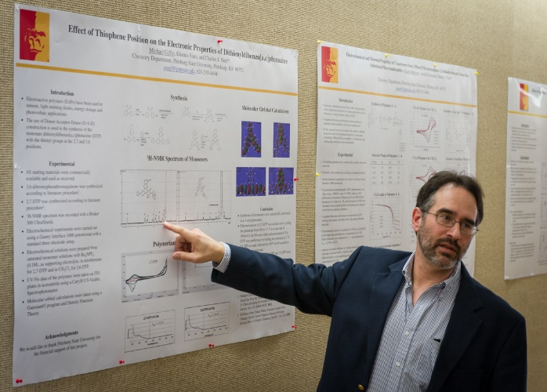
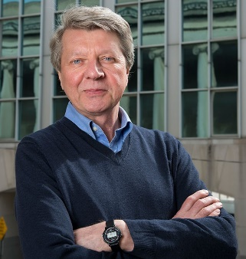
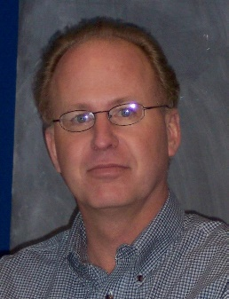
chemistry
Graduated 13 BS and 8 MS students.
Started 2 new accelerated MS programs: one in Chemistry and one in Polymer Chemistry.
More than doubled the number of MS students from 10-12/year to 25 in Fall 2016 of which 15 are on externally funded scholarships.
Published 13 original research papers and gave over 50 lectures and presentations at various PSU, regional, national and international scientific meetings.
Students won 4 awards at regional scientific meetings and faculty won 2 PSU awards. Seven of our students will win awards from PSU Graduate School Research Colloquium.
Brought in over $0.5M in new grants and contracts.
Hosted two distinguished scientists for the 2016 Spring Distinguished Polymer Lecturer Series.
Krzysztof Matyjaszewshi Carnegie Mellon University
Thomas McCarthy University of Massachusetts

Slide 11
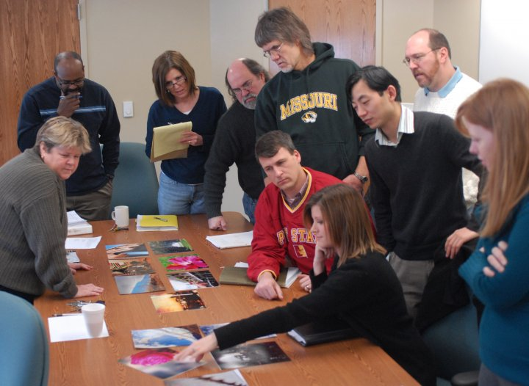
Communication
Faculty Alicia Mason and co-author Elizabeth Spencer, graduate student, have an article coming out in the International Journal of Communication and Health.
Faculty Trent Kling won the 2016 Broadcast Educator’s Association Festival of Media Arts Best of Competition in the category of Sports Radio.
Students won 38 awards at the Kansas Association of Broadcasters.
Produced by student Adrian Herrera, the documentary “We Not Me: A Kansas Basketball Story” won the College Broadcasters, Inc. national award for Best Documentary in 2015.
Faculty Joey Pogue and 10 students will be presenting at the 25th Annual Undergraduate Communication Research Conference this month.

Slide 12
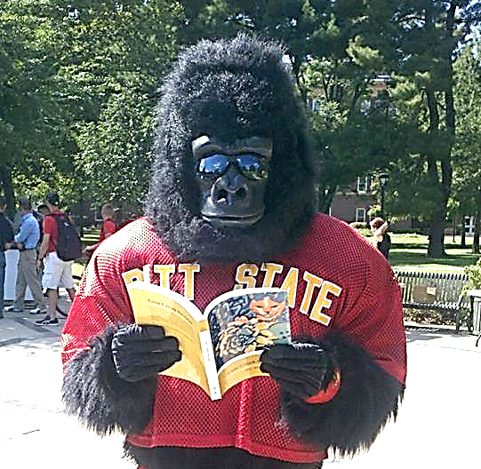
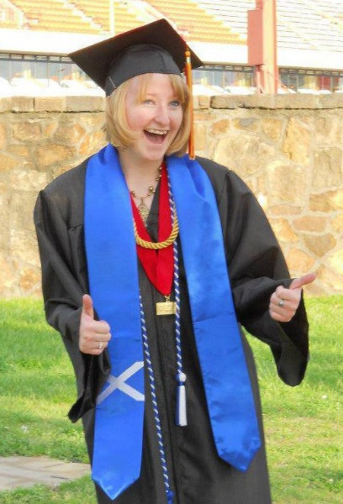
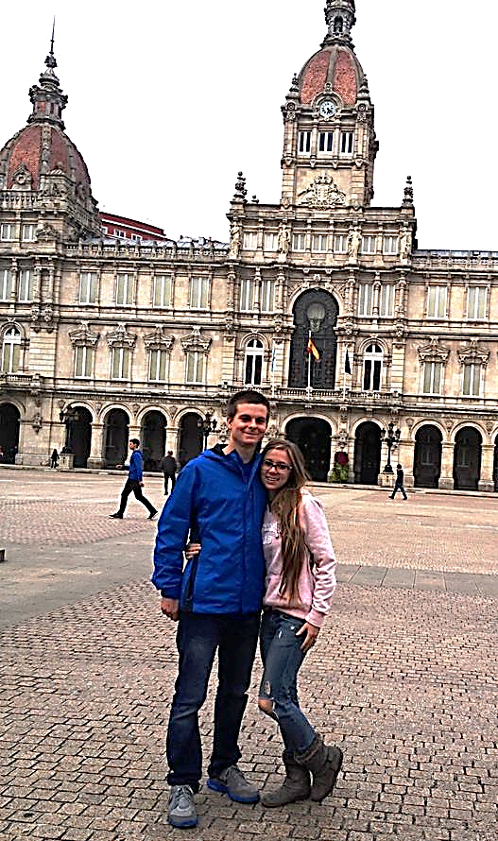
English and Modern Languages
The Writing Center served 3500 students and the Conversation Partners program served 100 students.
Faculty published two academic books, seven short fiction readers and 30 poems.
Faculty conference presentations numbered approximately 30. Three faculty served as journal editors for their professional fields.
Eleven students (G and U) gave presentations at regional or national conferences.
Four students will be initiated into the National Collegiate Foreign Language Honor Society.
Three students, Spanish majors, are finalists for PSU Outstanding Senior Man and Senior Woman including Marcus Clem, Lynzee Flores and Heather Hartong.
Five students will be studying abroad in Spain this summer.

Slide 13
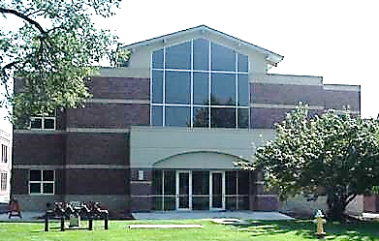
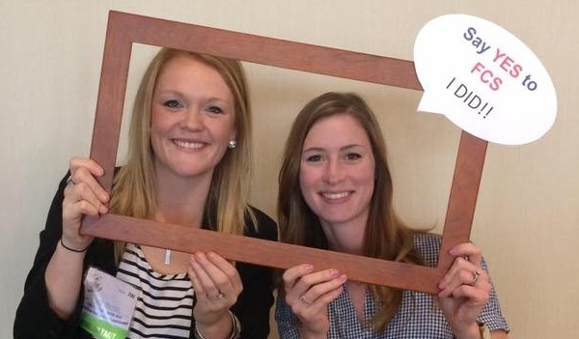
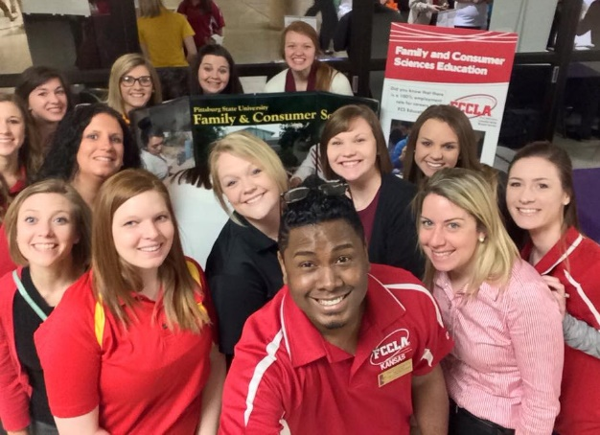
Family & consumer Sciences
As the only stealth program on campus, FCS students have an amazing homing mechanism allowing them to find their way to their building even without the way-finding signs that most students depend on to find their classes and buildings. (Only the senior chair of the A&S Leadership Team could submit this and have it included!!!!!!!)
Chair Whitbeck was elected as the incoming national President of the American Association of Family & Consumer Sciences. He is the second person from Kansas to have this position with the last being 75 years ago.
Chair Whitbeck and faculty Carol Werhan are leading an effort to research the national teacher shortage of F&CS teachers.
Faculty took over half of the F&CS students to professional development opportunities over the past two years including national, regional and state conferences.

Slide 14
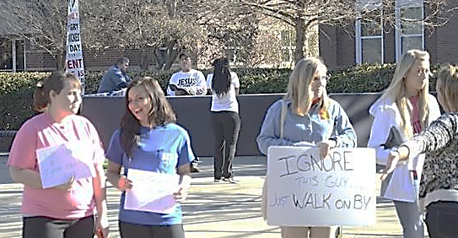
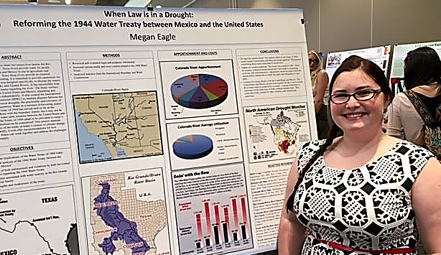
History, Philosophy and Social Sciences
Two alumni, Geography majors, are currently employed in city planning offices in Joplin, Missouri and Leavenworth, Kansas.
Social Work students were instrumental in their “Ignore the Hate” campaign, teaching fellow students how to defuse hate speech.
A public panel discussion was held with panel members from Political Science, Criminal Justice and Philosophy. The discussion was entitled “Kansas Campus Weapons’ Policy.”
Philosophy hosted on campus the annual meeting of the Kansas Philosophical Society.
Nine students presented research at the 2016 Research Colloquium and faculty have many publications in peer-reviewed journals, conference presentations and grant proposals.

Slide 15
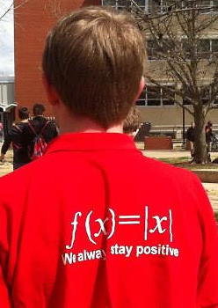
Mathematics
Faculty Ananda Jayawardhana is serving as the chair of the Council of Chapters Governing Board of the American Statistical Association.
Faculty Cynthia Huffman received the 2015 Kansas Section of the Mathematical Association of America Award for Distinguished College or University Teaching of Mathematics.
‘We always stay positive’
Faculty Jeremy Wade, George Kaemmerling and Bobby Winters have each been recognized and honored by the Faculty Athletic Council and Intercollegiate Athletics for continued support and dedication to Pittsburg State University student athletes.

Slide 16
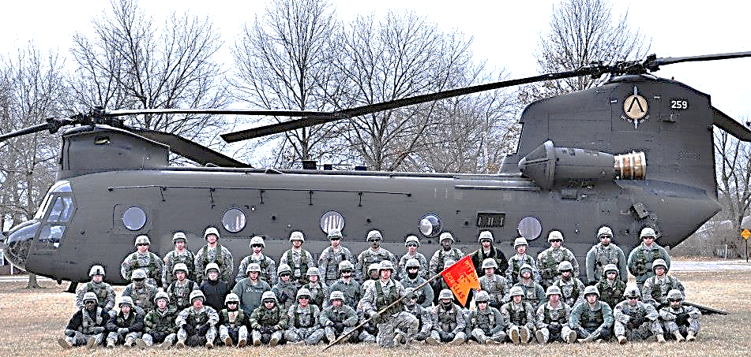
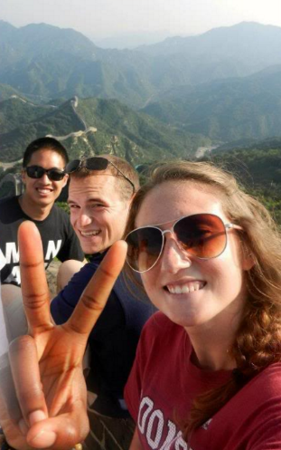
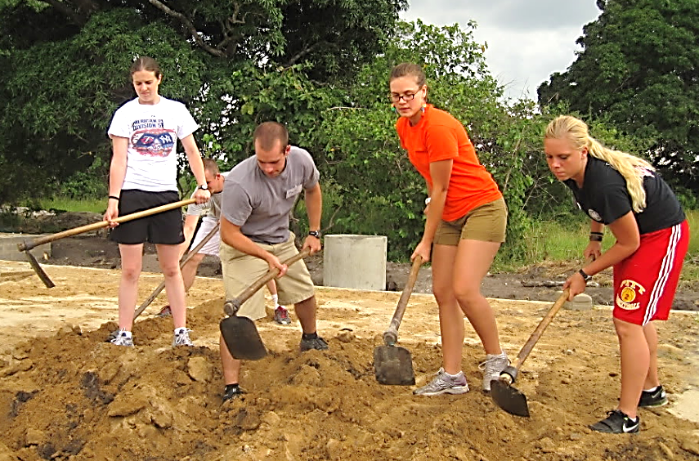
Military Science
Student Hannah Dalke will attend the Nurse Summer Training Program at Fort Bragg, North Carolina. Hannah will experience over 140 clinical hours to better prepare her for the nursing profession.
Student Emily Kurec will attend Air Assault School at Fort Benning, Georgia.
Three cadets will be attending Cutural Understanding and Language Proficiency in the countries of Montenegro, Nepal and Paraguay. The program gives cadets the ability to immerse themselves in a new culture and see how others around the world view the U.S.
Student Josh Bosley will live in Morocco for two months with Project Go in order to further his Arabic language skills and gain understanding of the Arabic culture.
Student Tanner Quigley attended the George C. Marshall Awards and Leadership Seminar with 274 top cadets from across the country.

Slide 17
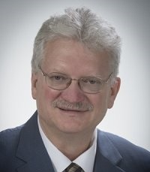
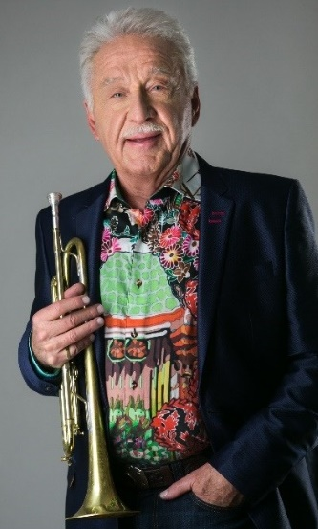
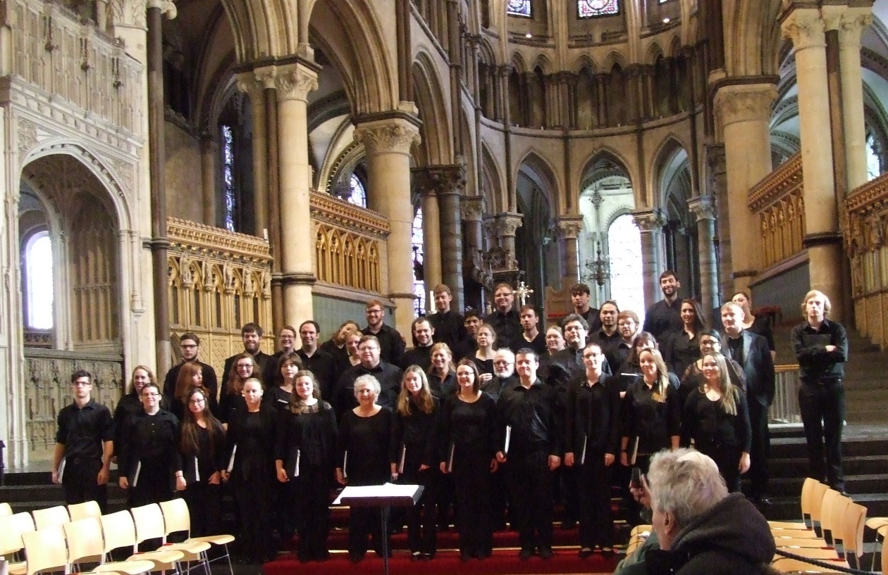
Music
Faculty David Hurley continues to be recognized internationally as a scholar in the music of George Frederick Handel. He was an invited speaker at the Handel Institute in London.
Our choirs mounted a very successful international tour in March 2016 with performances throughout Wales and England. Included among the historic venues were Bath Abbey and Gloucester, Ely and Canterbury Cathedrals.
The PSU Jazz Ensemble gave a stellar performance as collaborative musicians with the legendary Doc Severinson. This performance took place during the 42nd Annual PSU Jazz Festival, an enormous event attracting student ensembles from more than 65 schools in the region.
The PSU Wind Ensemble was selected to perform at the annual In-Service Workshop of the Kansas Music Educators Association.

Slide 18
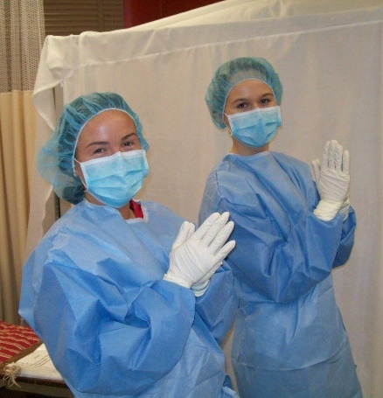
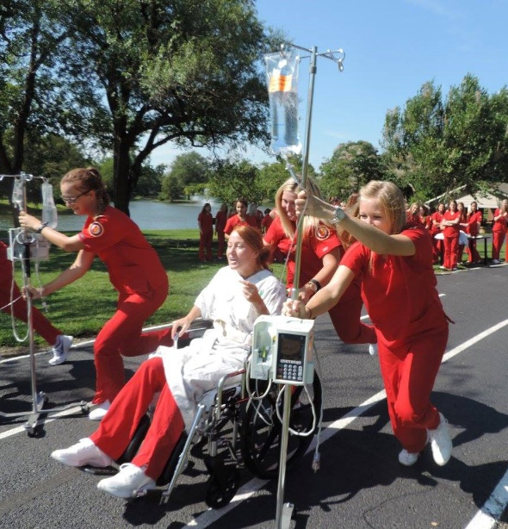
Nursing
The inaugural class of the DNP program started in June of 2016 with 16 students.
Undergraduate students Kayla Kenne and Megan Downing presented a research poster with faculty Bardie McClaskey in Orlando, Florida at the National Student Nurses Association convention.
Ten students participated in a service learning project at a Program of All Inclusive Care for the Elderly (PACE) center in New Orleans, Louisiana during Intersession.
The Bachelor of Science in Nursing graduates exceeded the national mean for first-time test takers on the national certification examination NCLEX-RN for Calendar Year 2015. The pass rate for first-time test takers on the national certification examination for family nurse practitioners was 96% for the 2015 Calendar Year graduates.
The school is collaborating with the University of Kansas on two research grants.

Slide 19
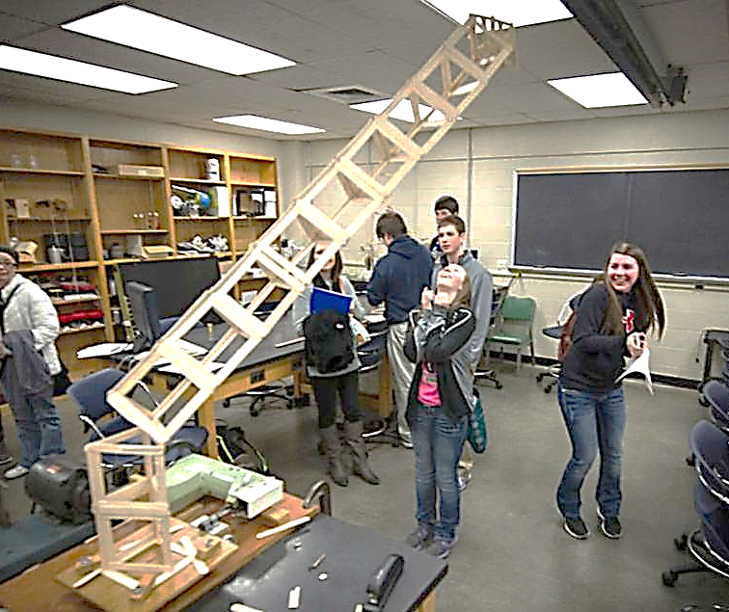
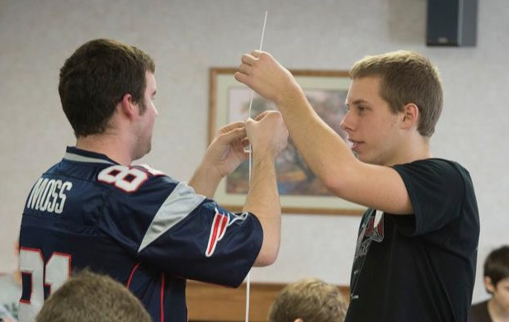
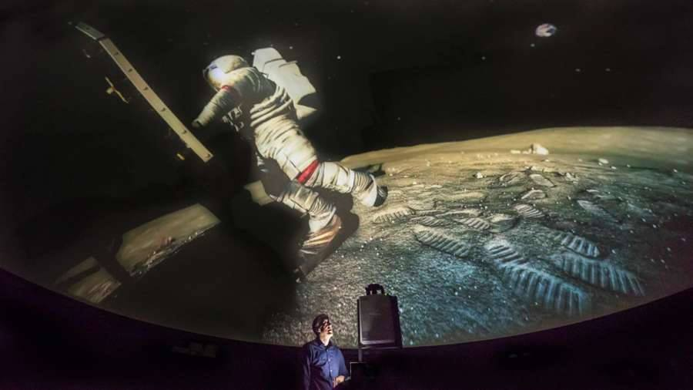
Physics
The PSU Society of Physics Students, advised by faculty Serif Uran, was recognized as “Outstanding Chapter for 2015”.
With leadership provided by faculty Kyla Scarborough, Science Day hosted a total of 22 high schools and 583 students.
The L. Russell Kelce Planetarium was renovated and is fully operational with a new digital projector.

Slide 20
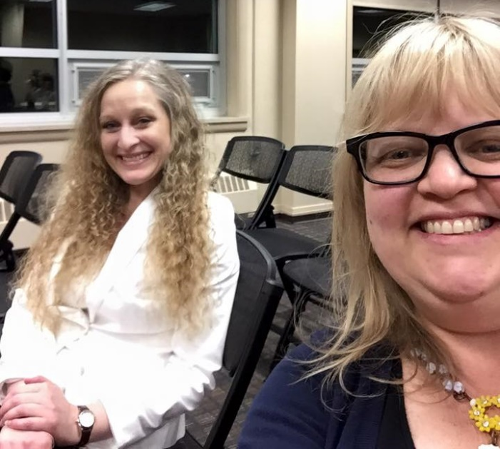
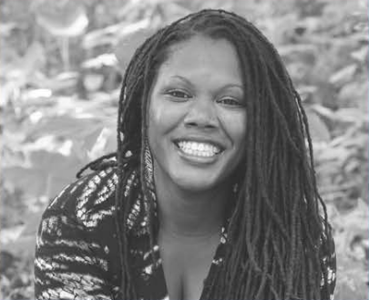
Women’s and Gender Studies
Joined the National Women’s Studies Association as an Institutional Member.
With support from the college, hosted the 2015 Women’s Studies Essay Contest and Karen Stolz Creative Writing Award, resulting in four student awards and two honorable mentions.
The Women’s Studies Lecture Series, supported by the Student Fee Council, sponsored a talk by Joshunda Sanders.
Co-Sponsored Visiting Writer Rilla Askew in association with Women’s History Month.
Completed General Education Assessment of both WGS 200 and 399, Spring 2016.

Slide 21
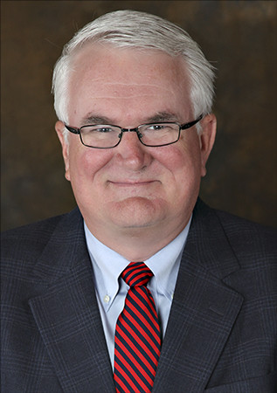
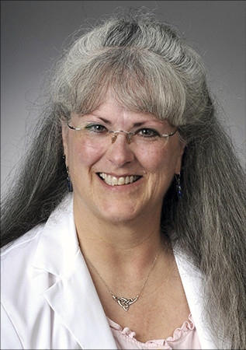
2016 meritorious achievement awardees
All three of the 2016 Meritorious Achievement Award recipients are Arts & Sciences Alumni
Ed McKechnie Executive V.P. and Chief Commercial Officer, Watco Bachelor’s Degree in Communication | Maureen Murphy Family Practice Physician and 2016 National Family Physician of the Year Bachelor’s Degree in English | Kenneth Nance Executive V.P. of Sales and V.P. of Government Sales, Fastenal Bachelor’s Degree and Master’s Degree in History

Slide 22
Thank You
Thank you for the commitment that you have made to our students, fellow faculty and staff, alumni and broader communities.
Your work is valued. Your work is important.
Your work makes a difference in the lives of others.
You are changing the world, one student, one graduate, one day at a time!

